Slide 1
An NSS Audio-Visual
Library Presentation
Locomotive Breath
Cave, VA
Paul and Lee Stevens (1990)
S745 68 Slides 2/14/2021

Slide 2
Notes:
This is the story of Locomotive Breath Cave

Slide 3
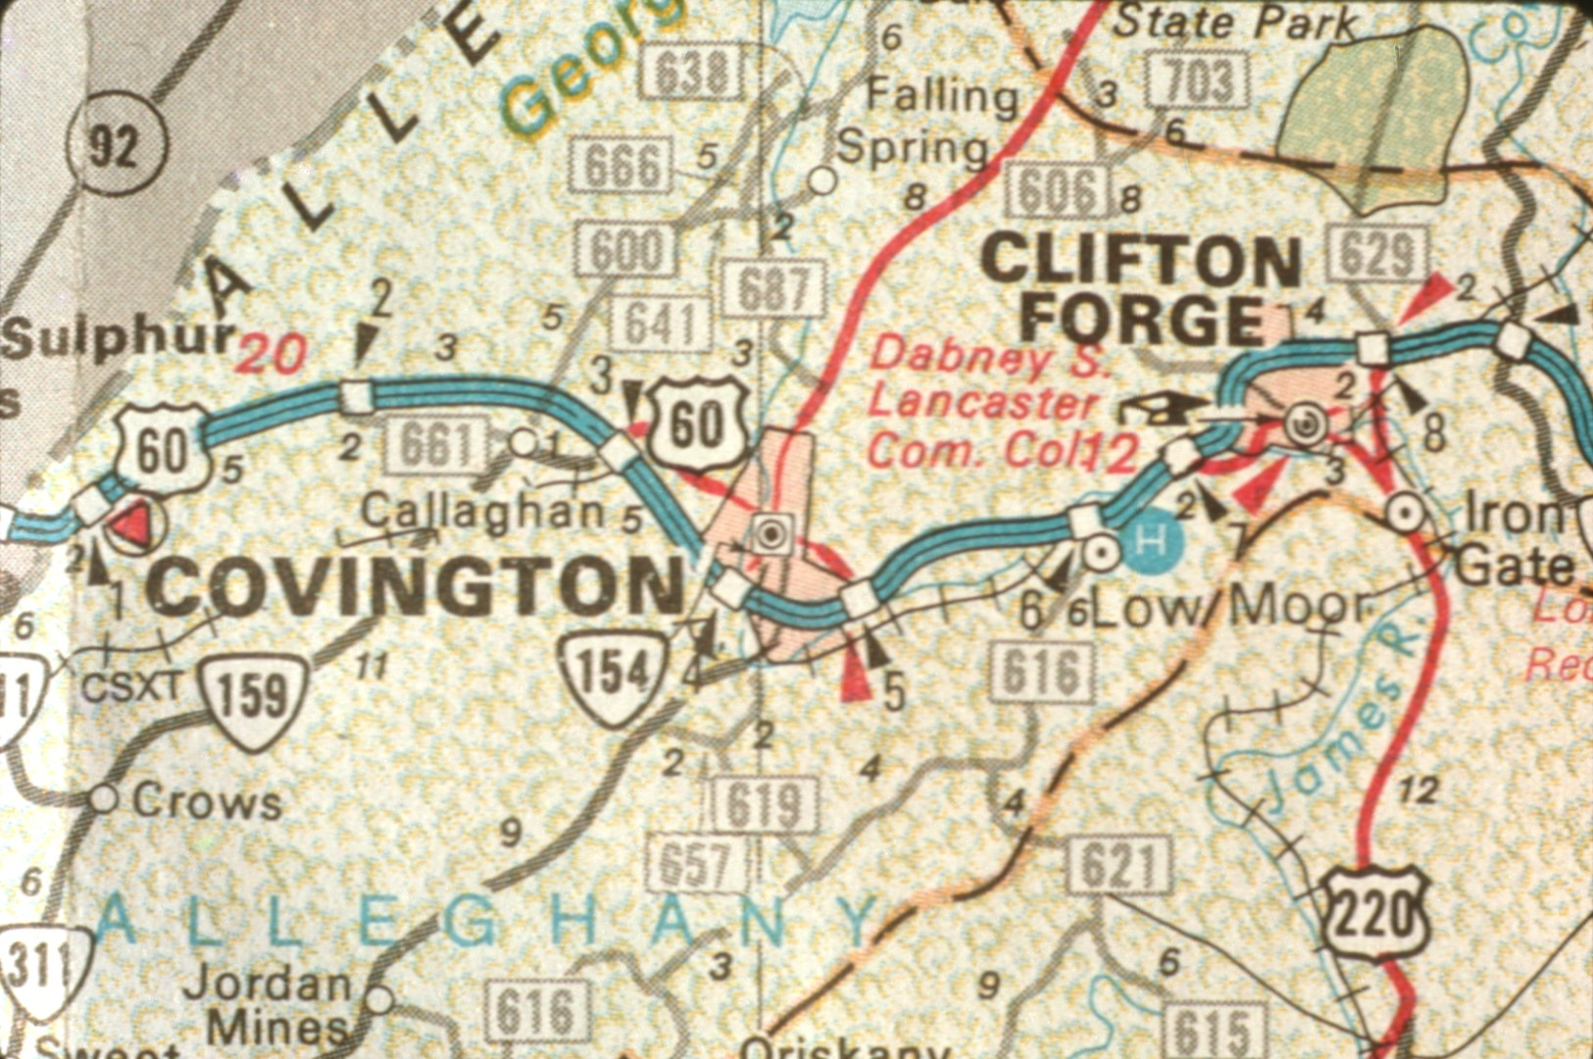
Notes:
Located just off Interstate 64 near Low Moor, it's the third largest cave in Alleghany County, Virginia.

Slide 4
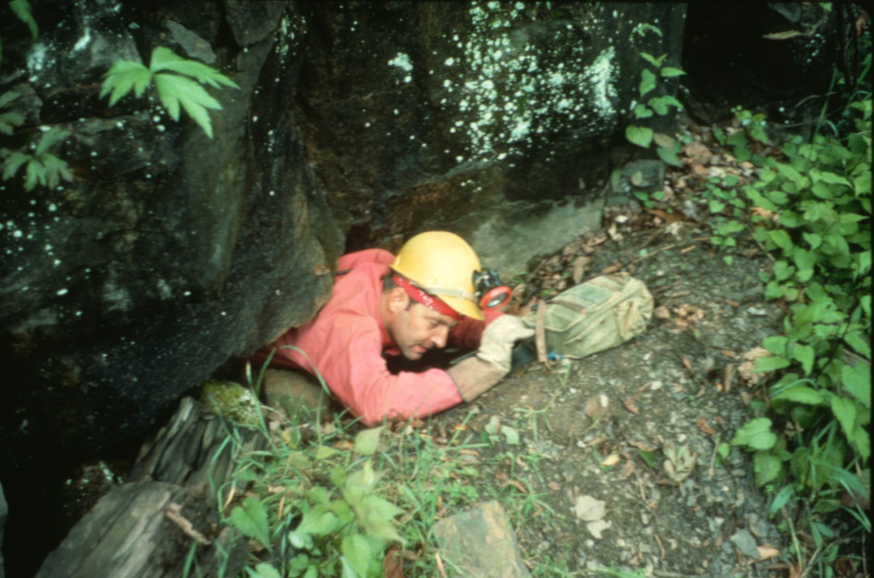
Notes:
The cave was discovered in 1974 by Billy Stull, a resident of the area. However, its existence was not generally known until 1988 when caves from the Virginia Speleological Survey met Billy by chance and asked if he knew of any caves.

Slide 5
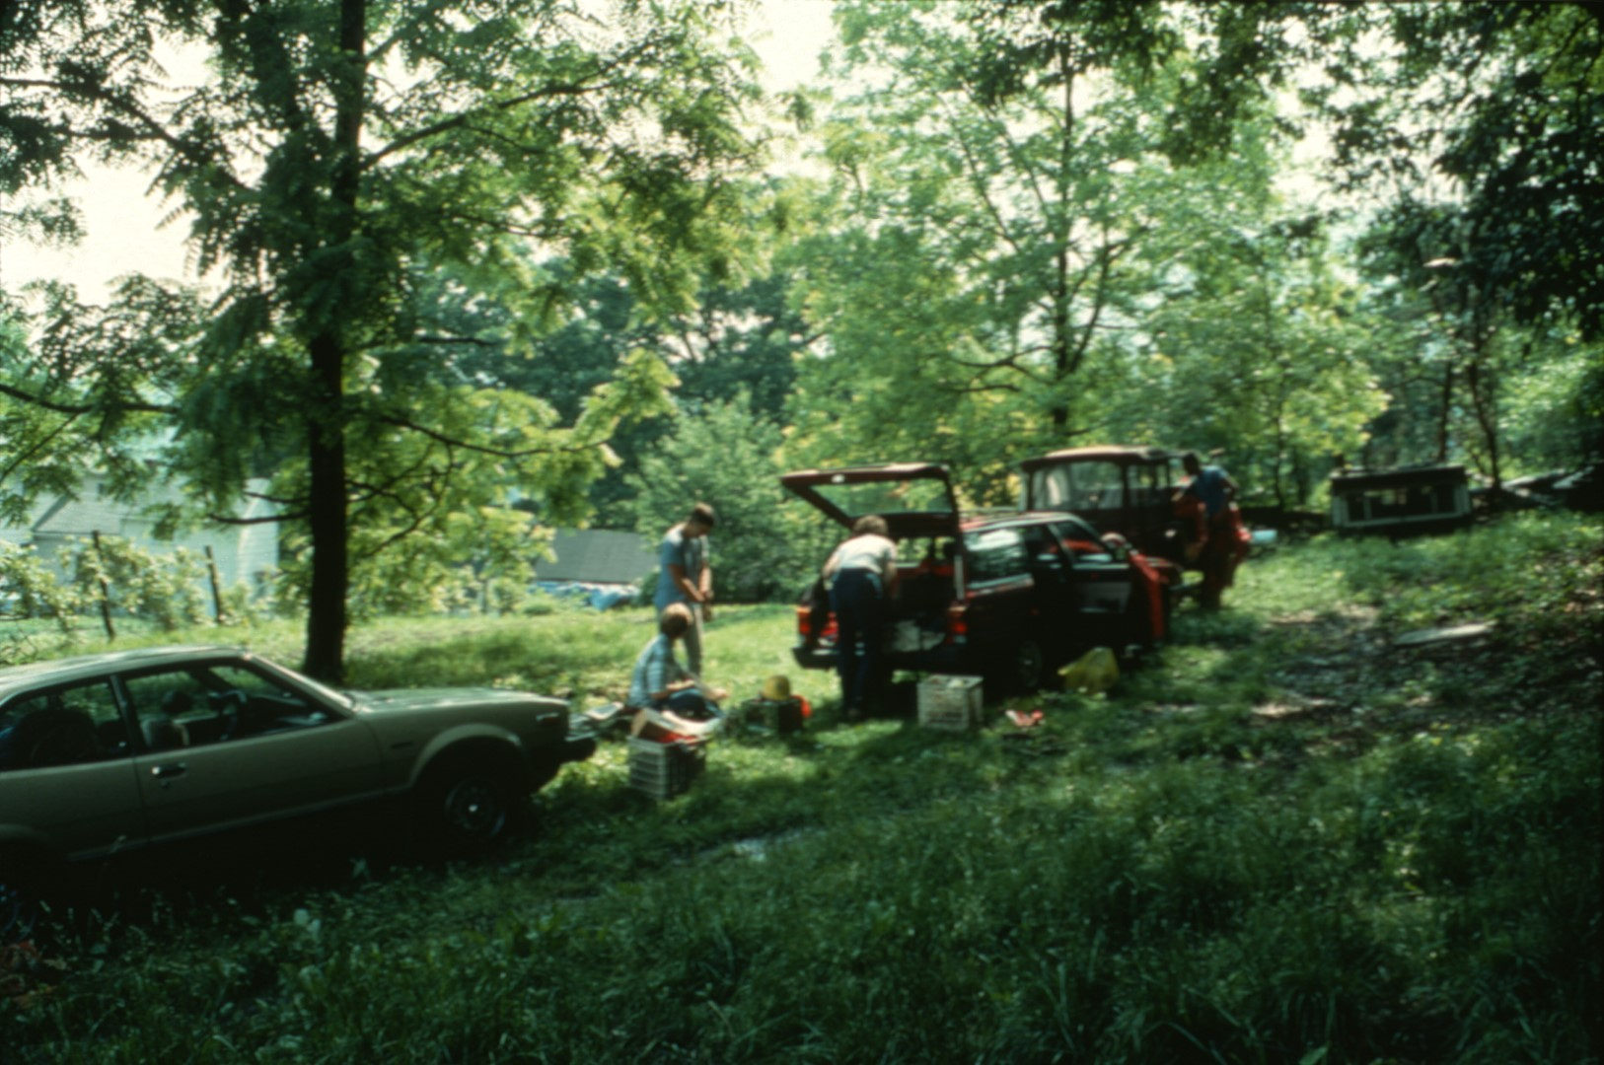
Notes:
After talking with the nearby landowner and putting on their gear, ...

Slide 6
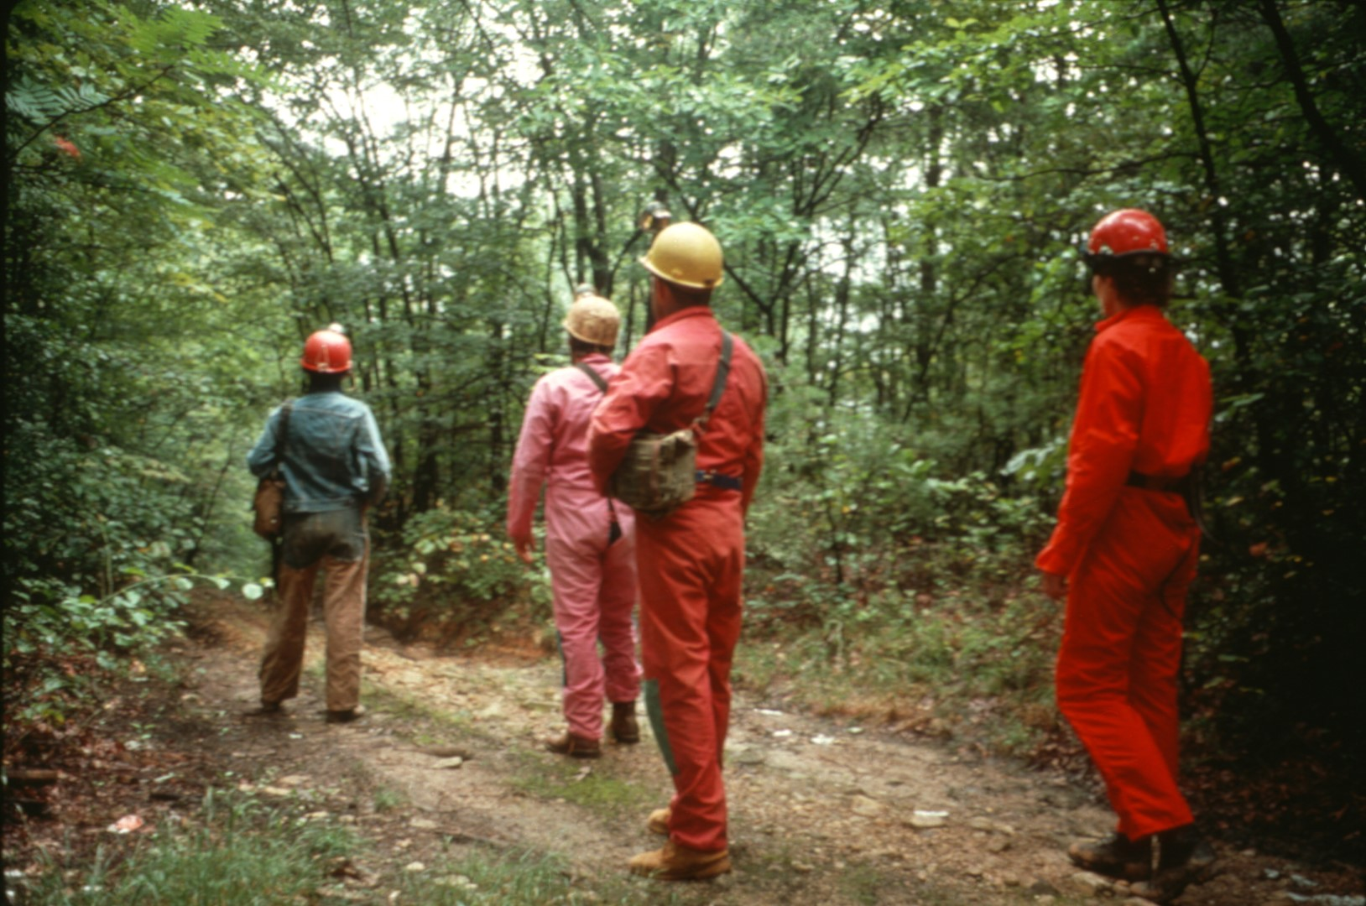
Notes:
cavers must hike a half mile through a forest ...

Slide 7
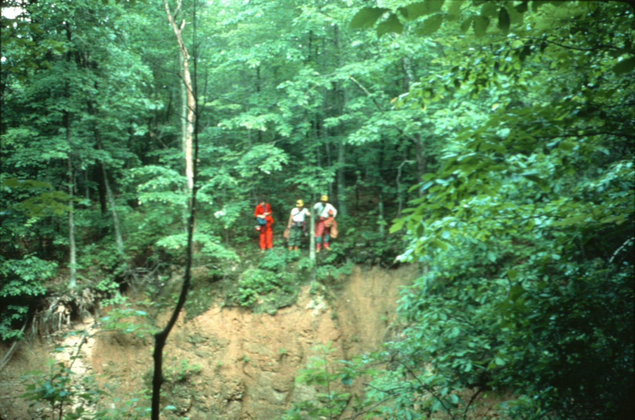
Notes:
dotted with pits ...

Slide 8
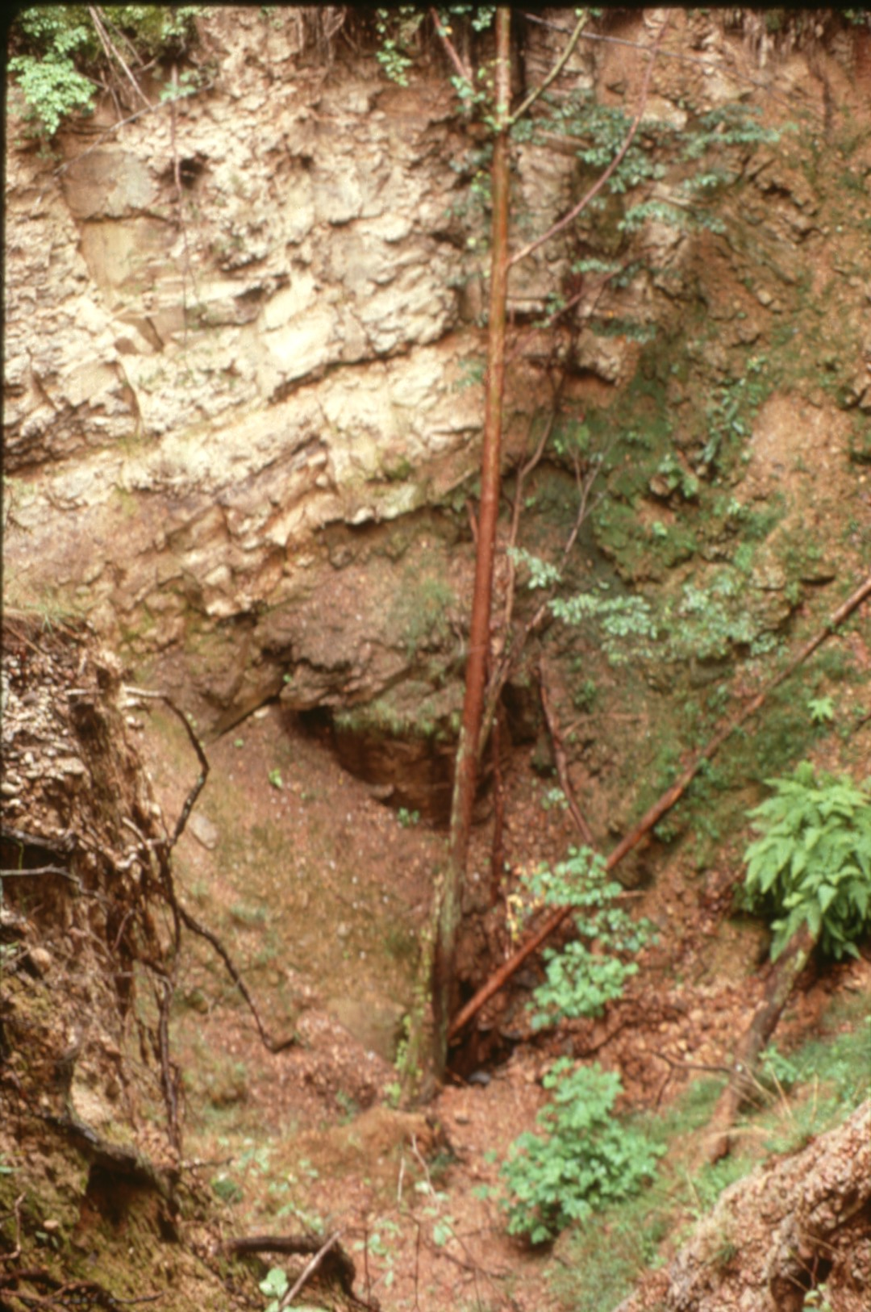
Notes:
that mark the collapse of the Low Moor Mine below.

Slide 9
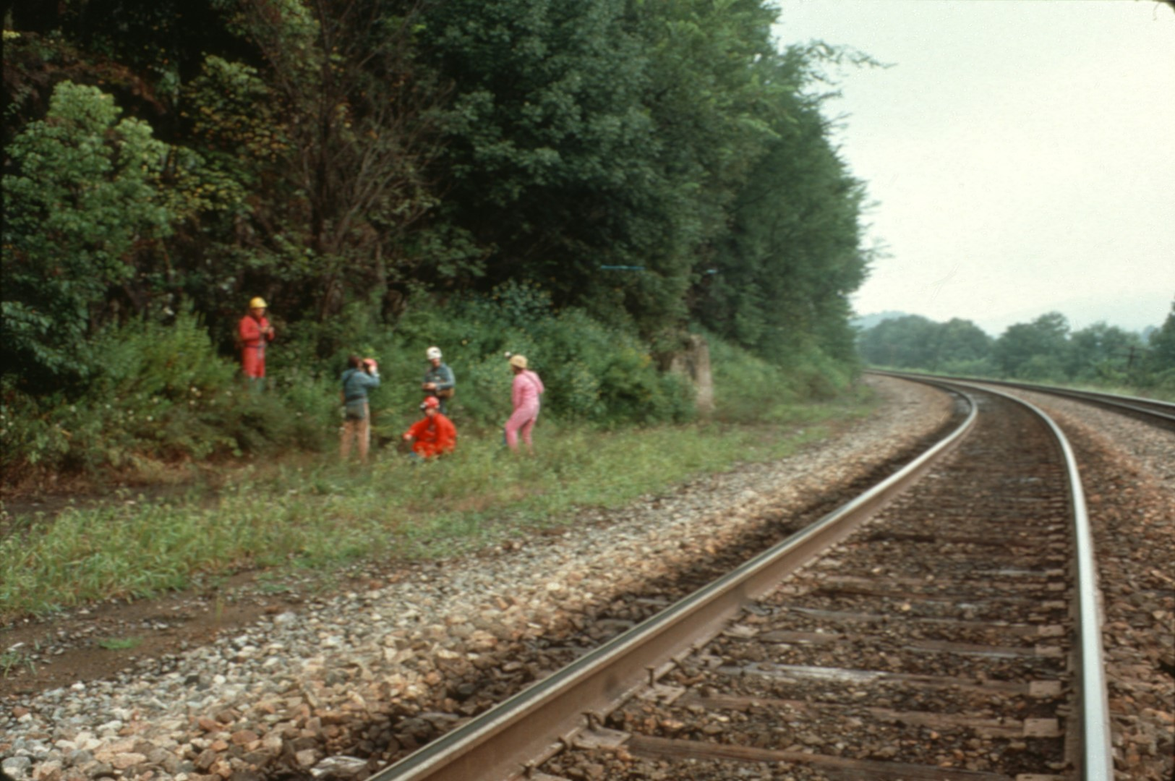
Notes:
The cave's entrance is located in cliffs along a remote section of railroad track.

Slide 10
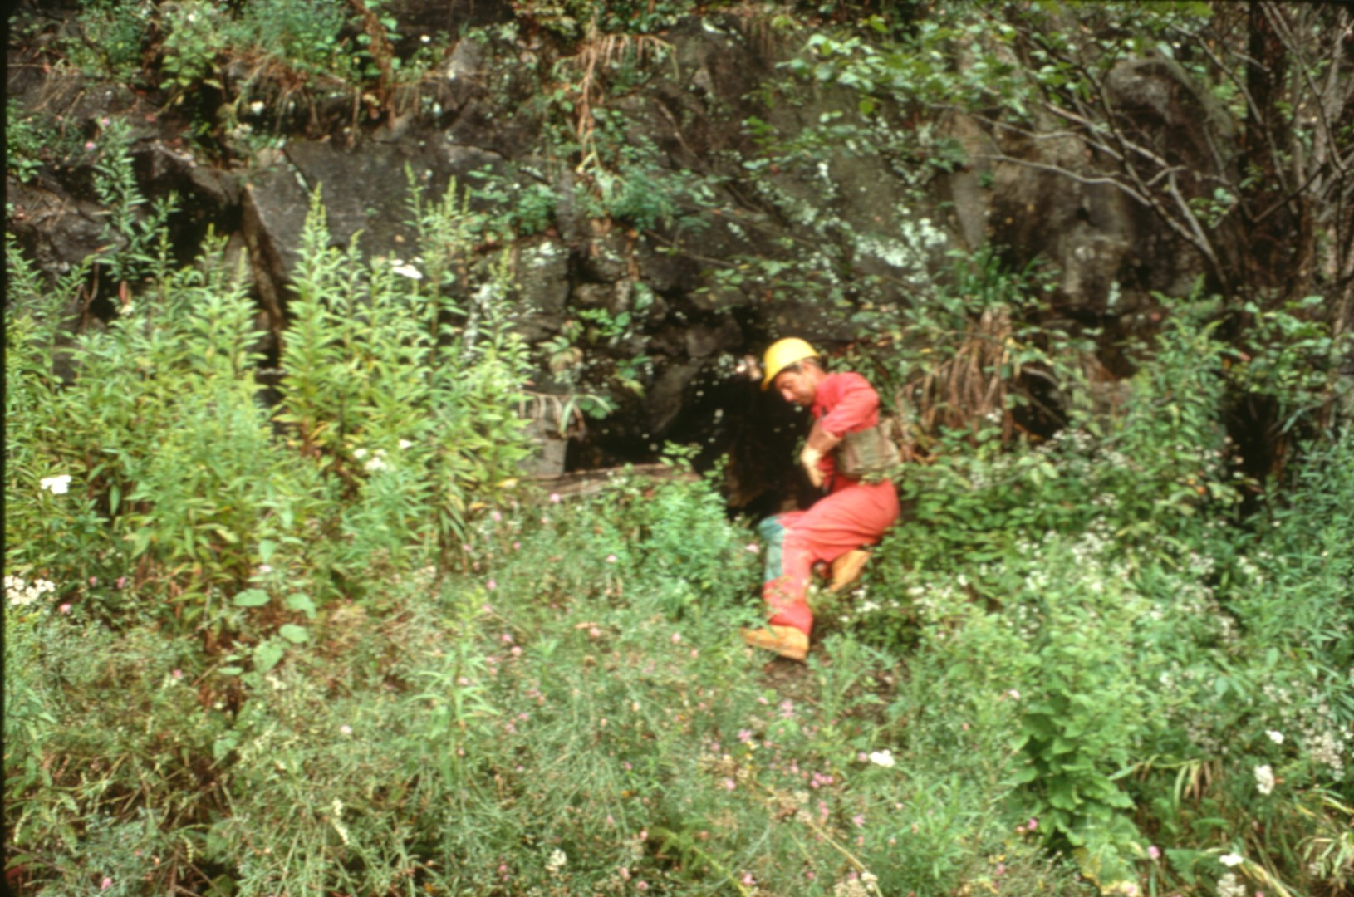
Notes:
It's very inconspicuous ...

Slide 11
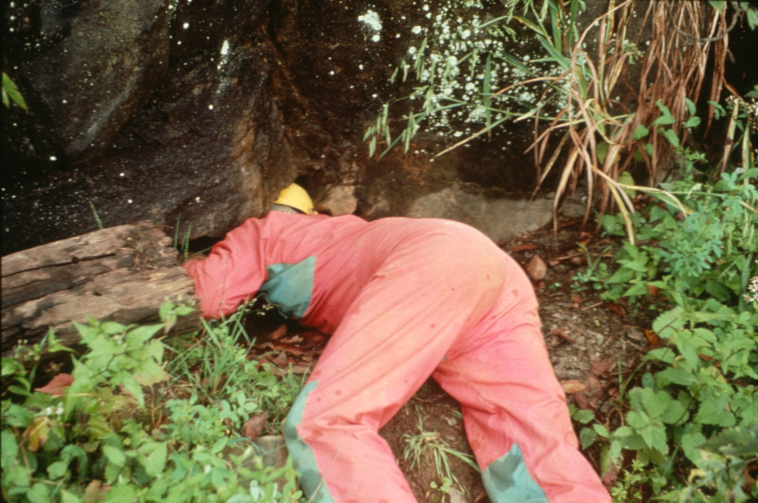
Notes:
and many a caver has walked by without noticing it.

Slide 12
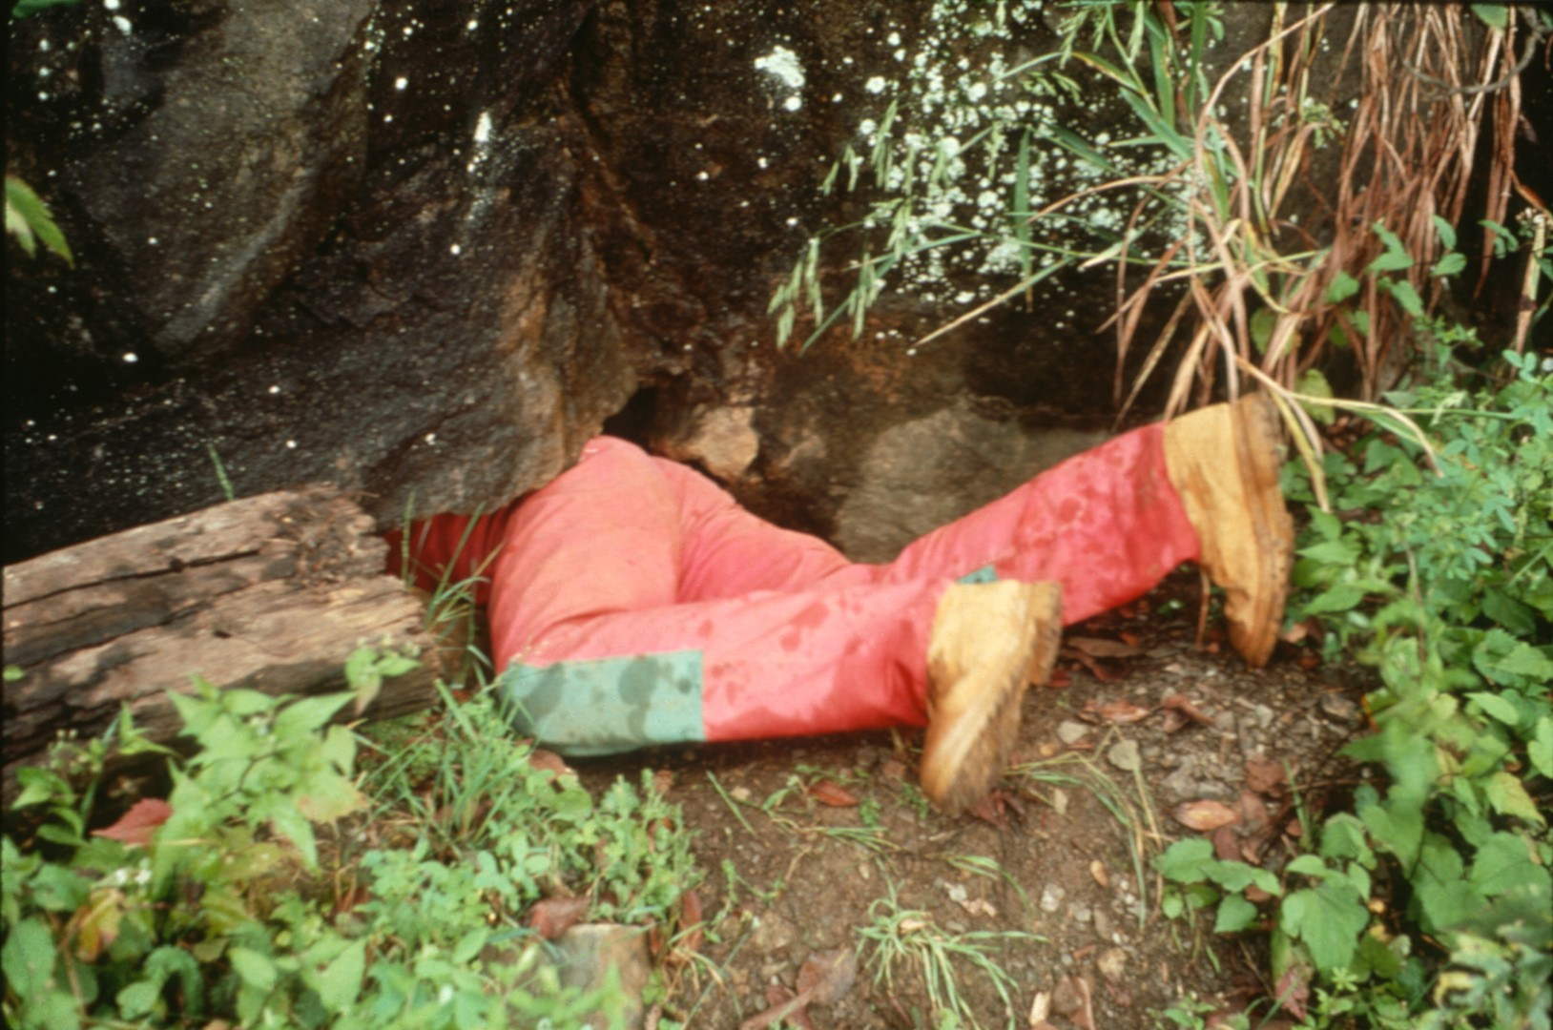
Notes:
Once through the short pinch…

Slide 13
Notes:
you can look back at the railroad track.

Slide 14
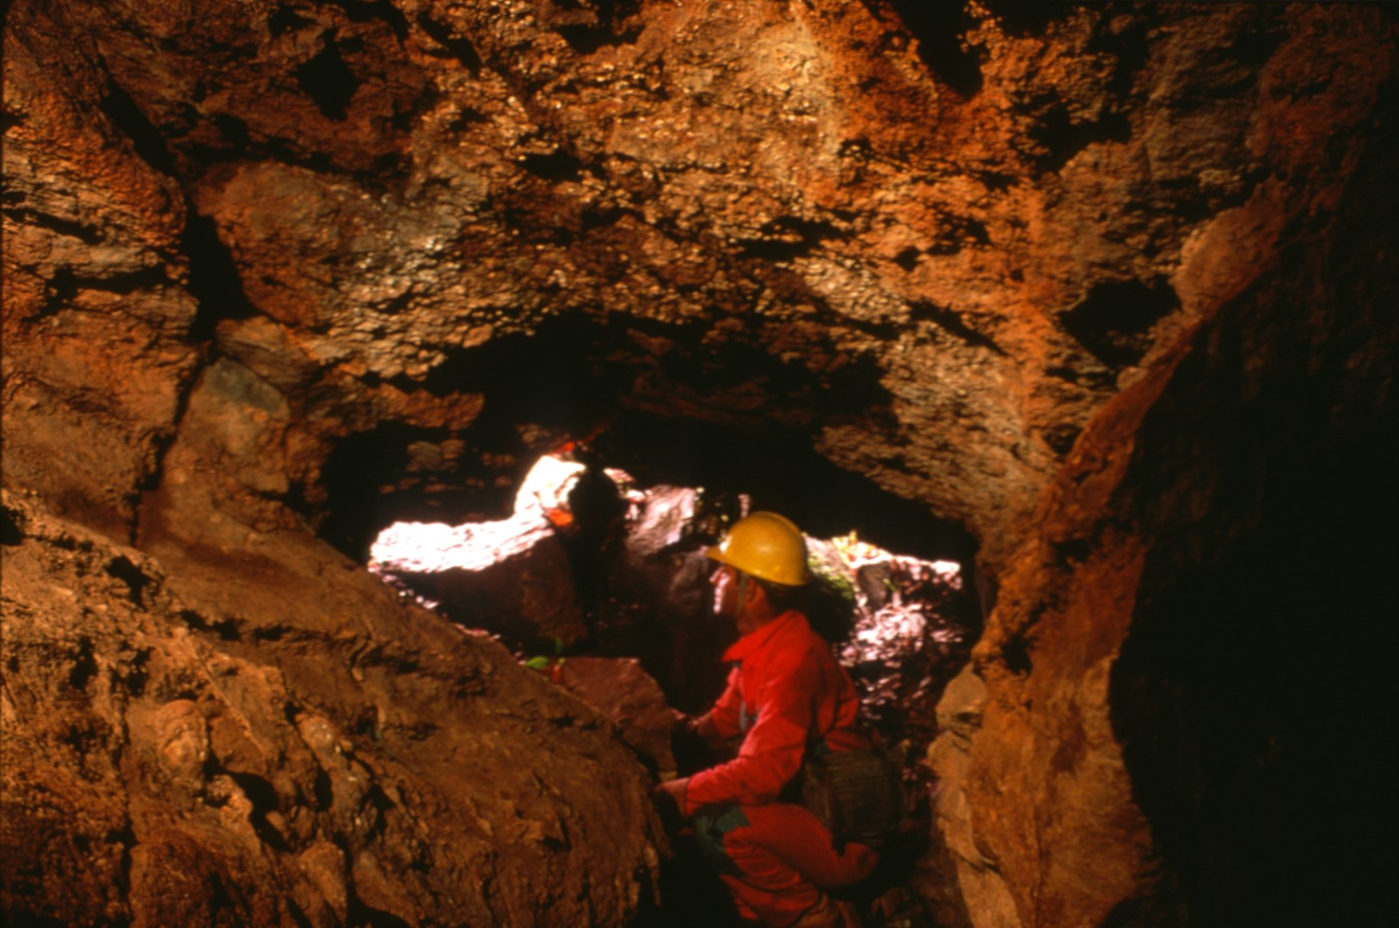
Notes:
When the next train comes by you’ll understand how it got its name.

Slide 15
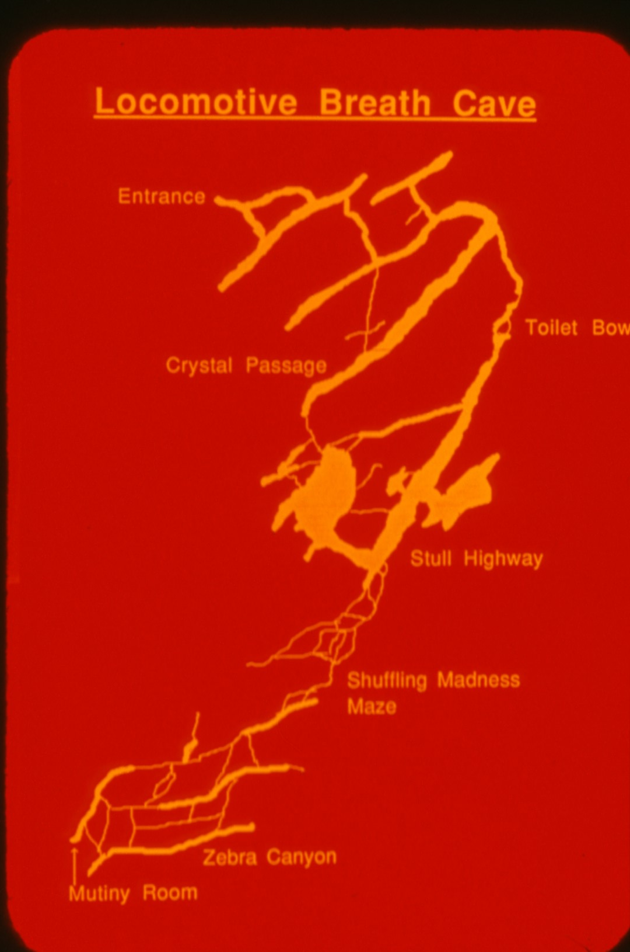
Notes:
So far about 8,000 feet of passage has been mapped in Locomotive Breath Cave.

Slide 16
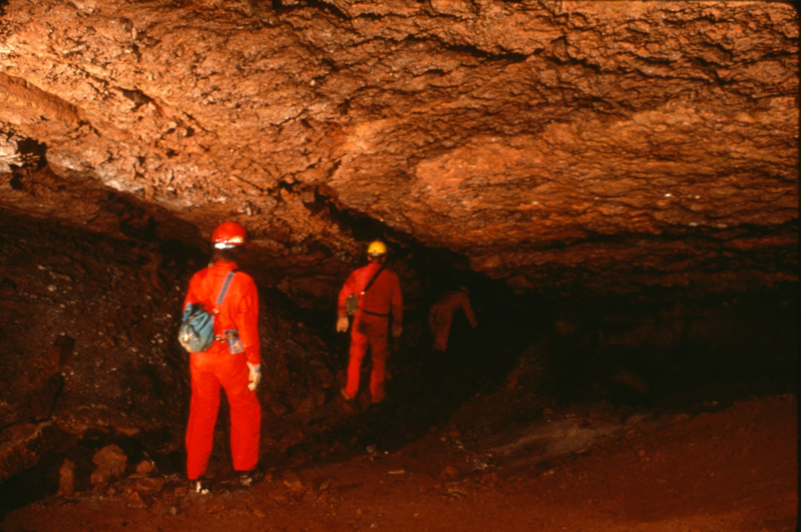
Notes:
While most of it is walking passage ...

Slide 17
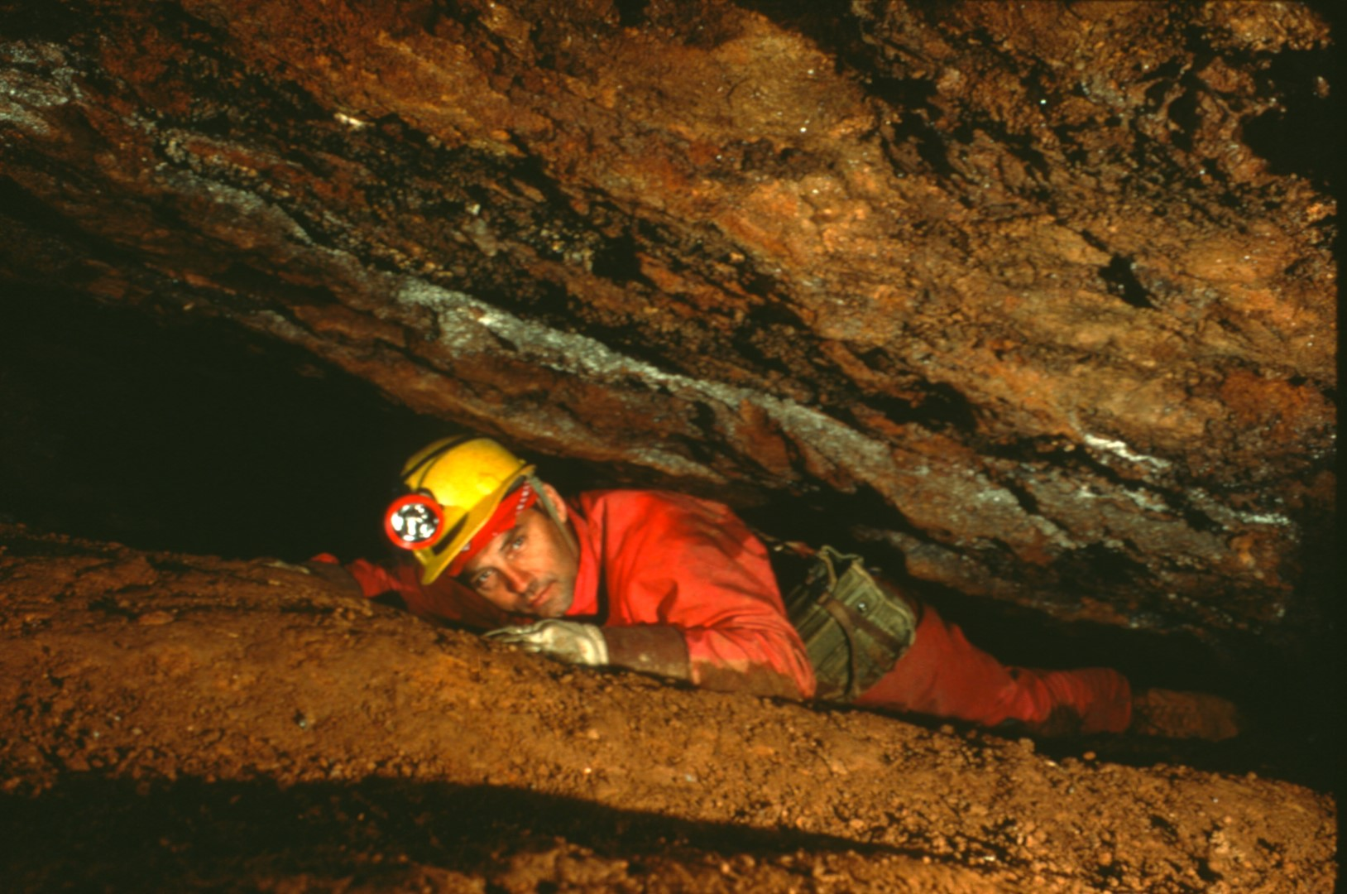
Notes:
there are some crawls ...

Slide 18
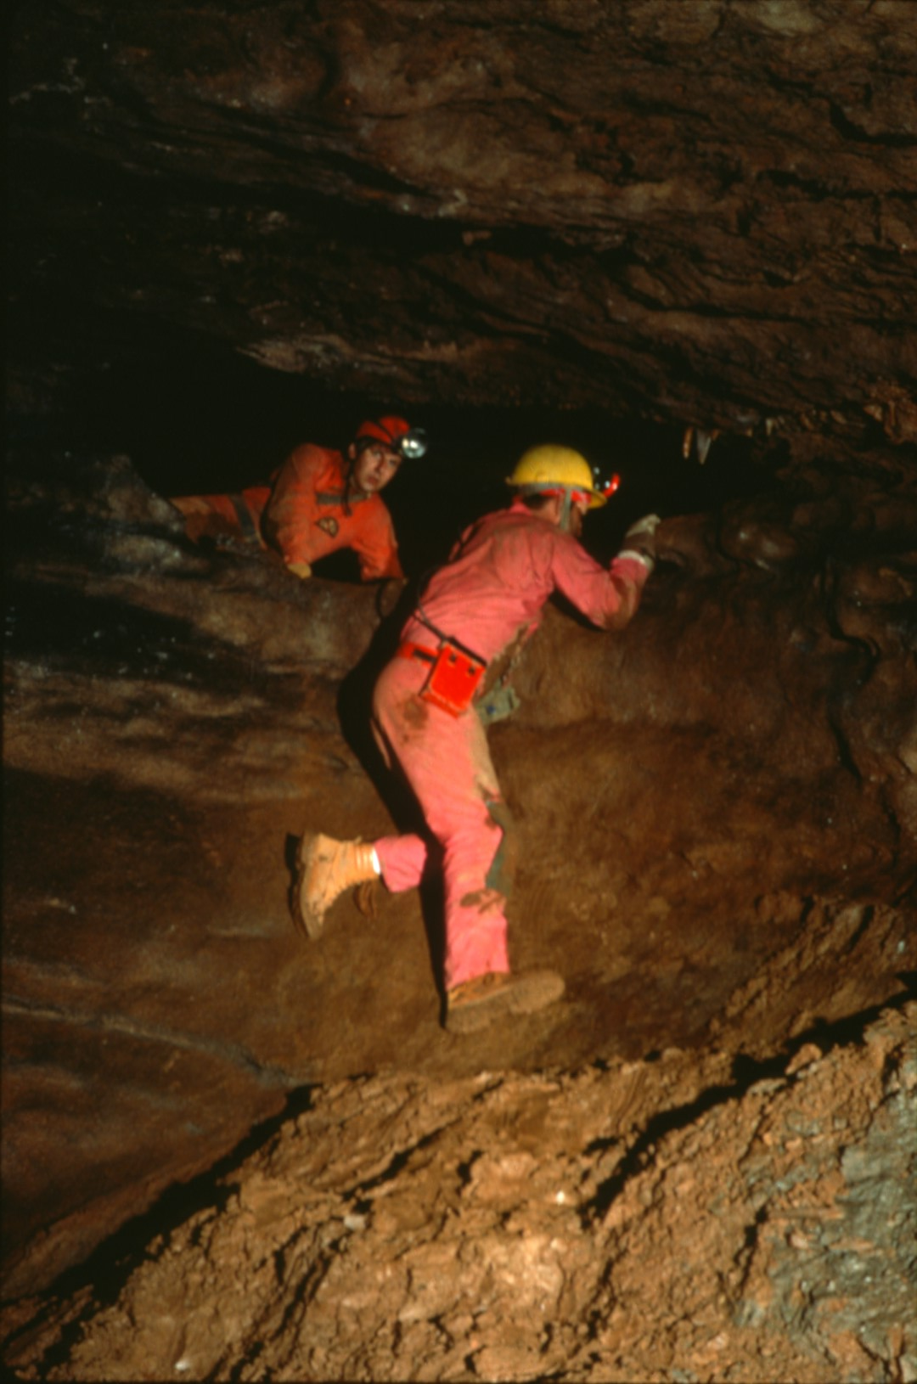
Notes:
and short vertical sections.

Slide 19
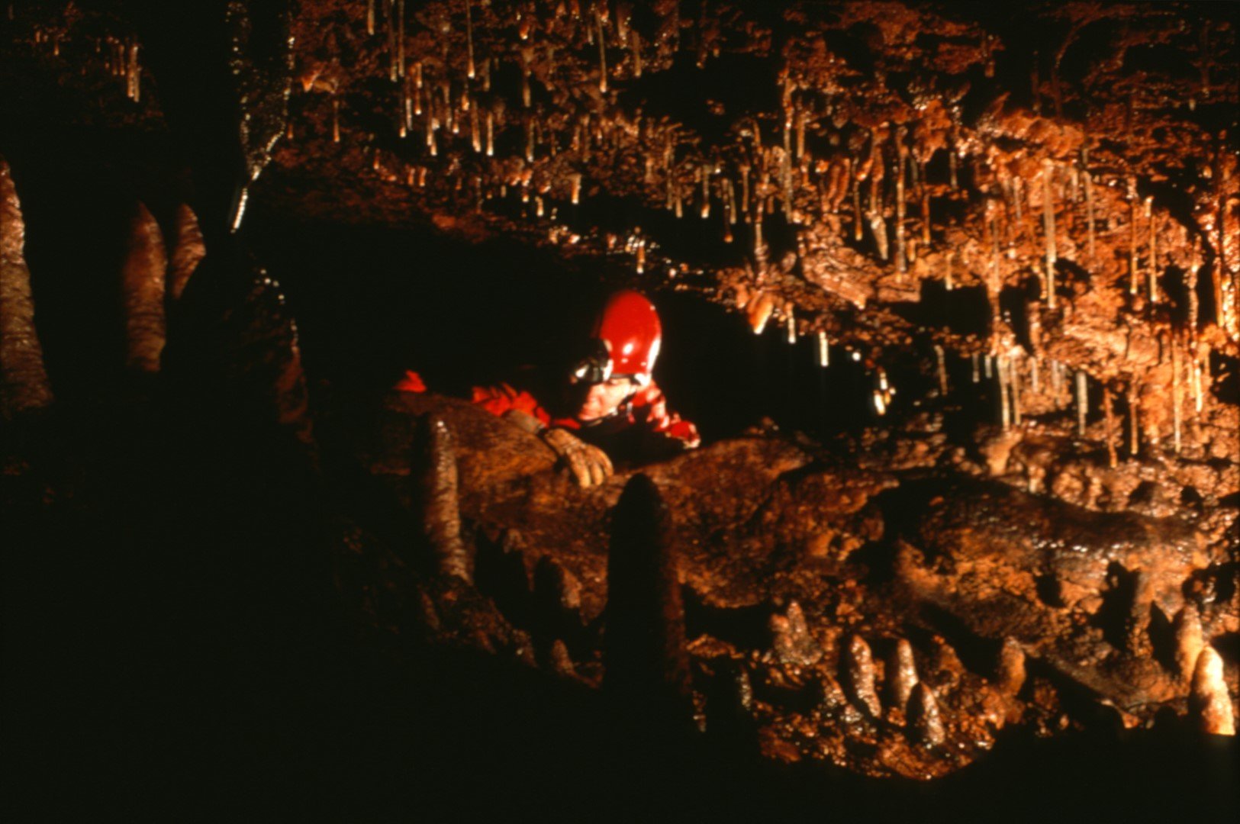
Notes:
Much of the cave is decorated.

Slide 20
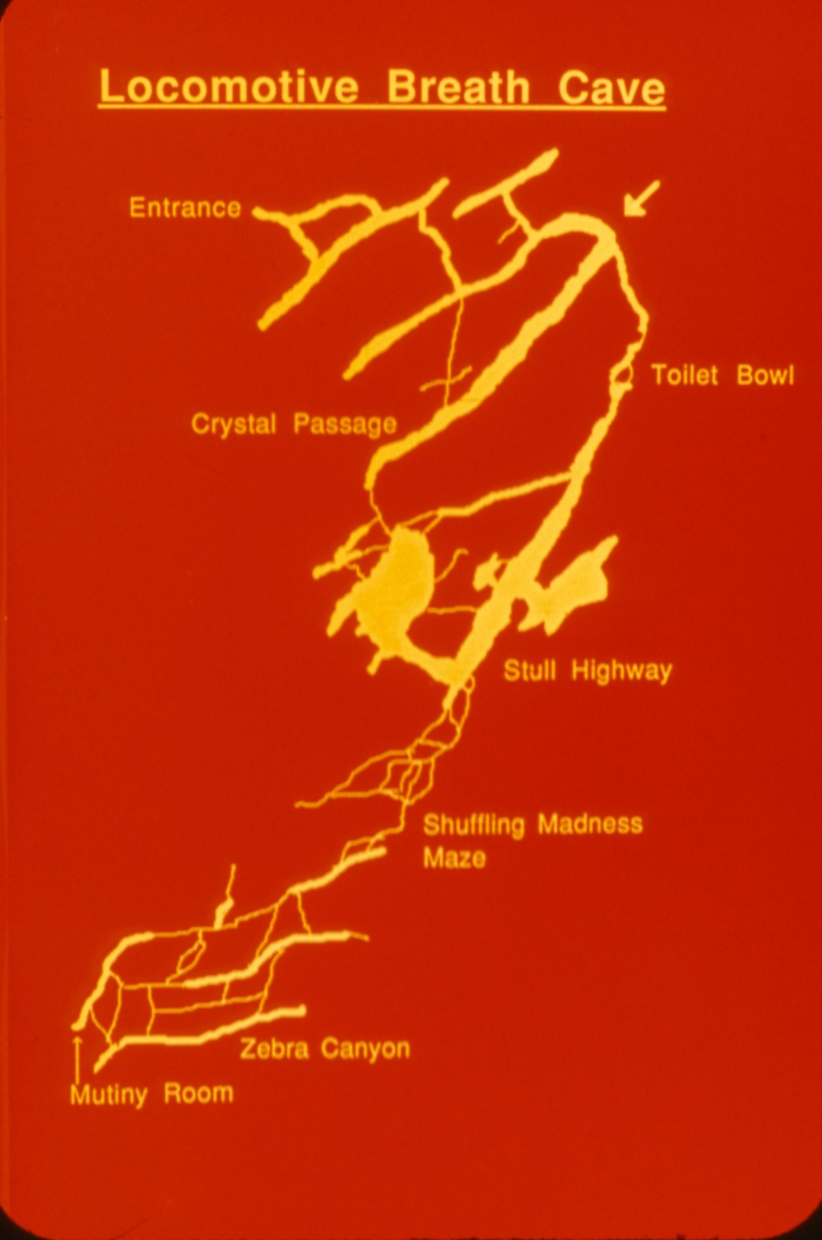
Notes:
The north end of Crystal Passage lies under the railroad tracks ...

Slide 21
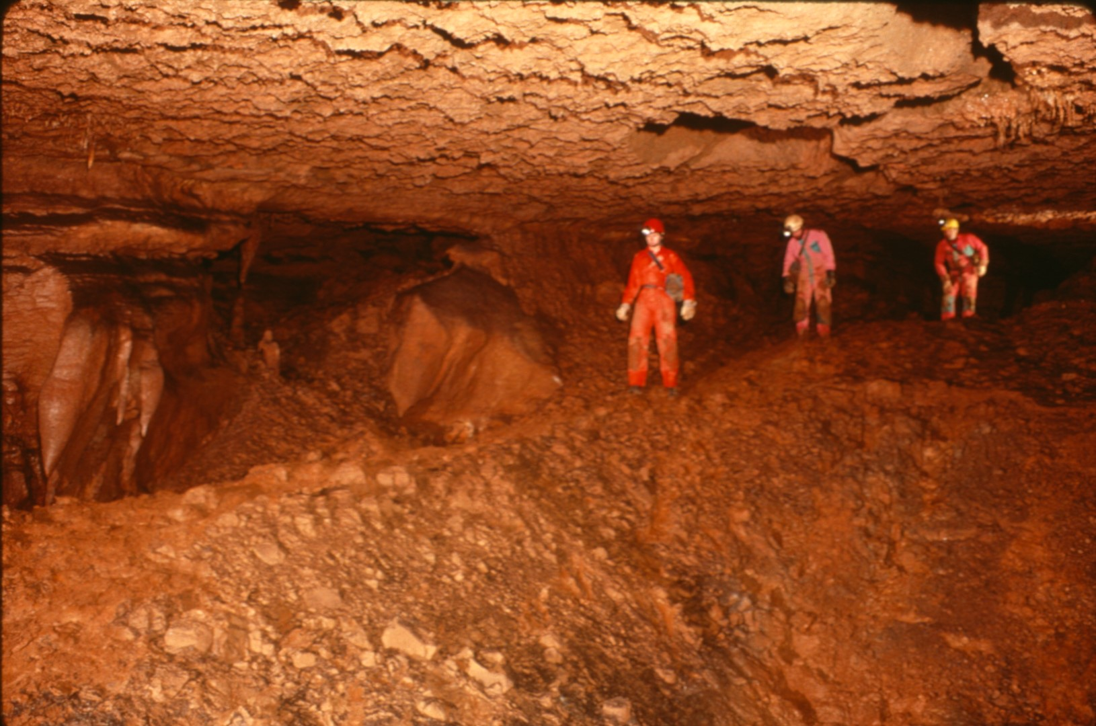
Notes:
and the ground rumbles when trains come by.

Slide 22
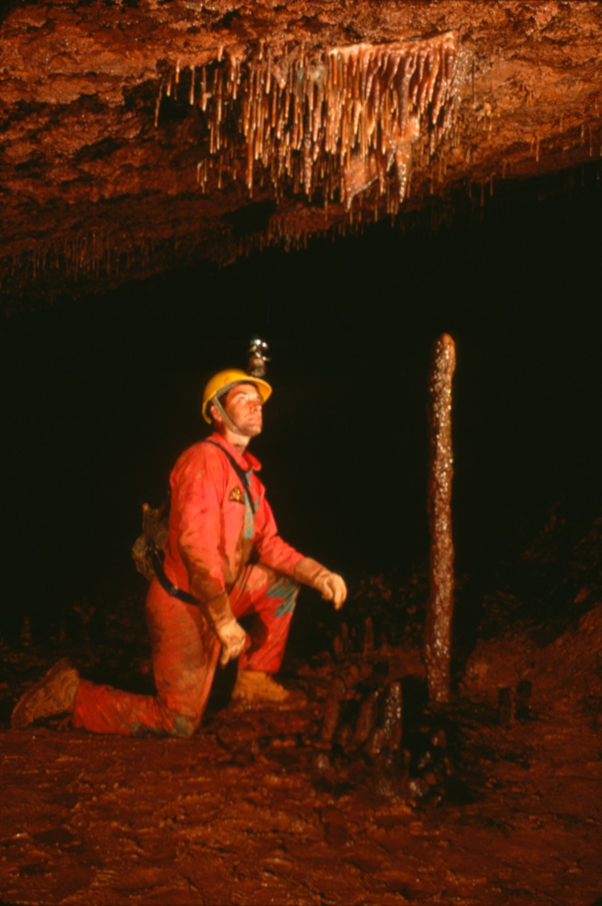
Notes:
This area has some of the better formations in the cave ...

Slide 23
Notes:
with nice displays of soda straws ...

Slide 24
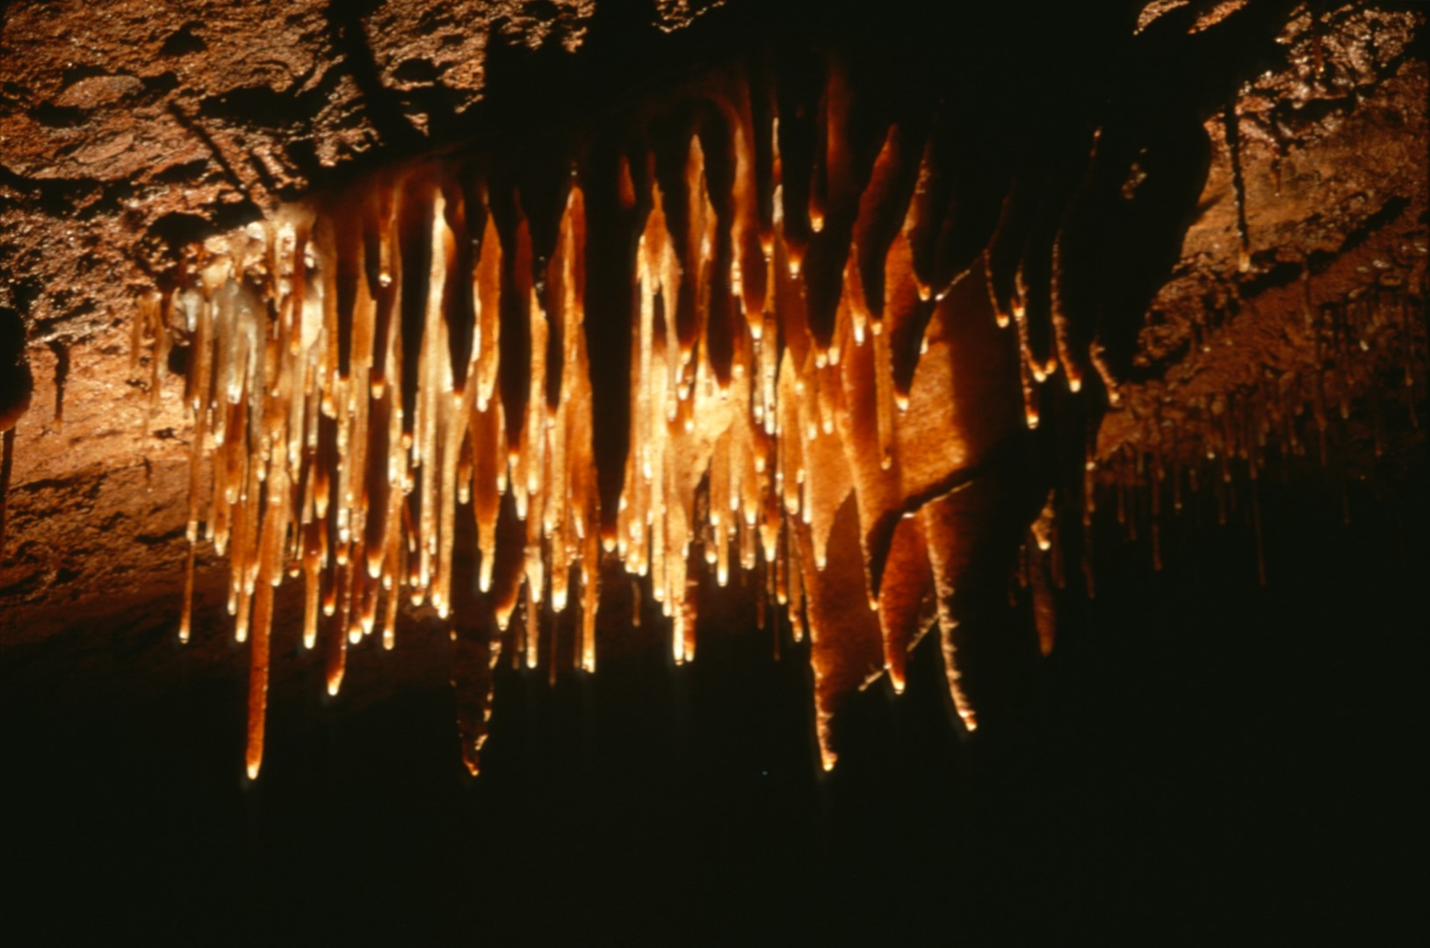
Notes:
in several locations.

Slide 25
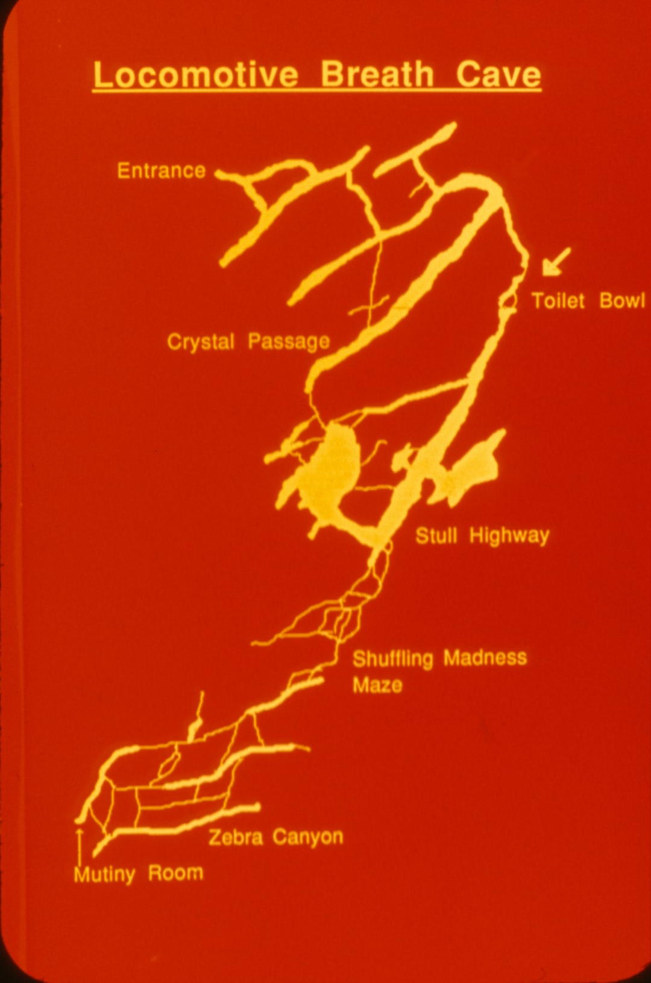
Notes:
On the way to the Toilet Bowl ...

Slide 26
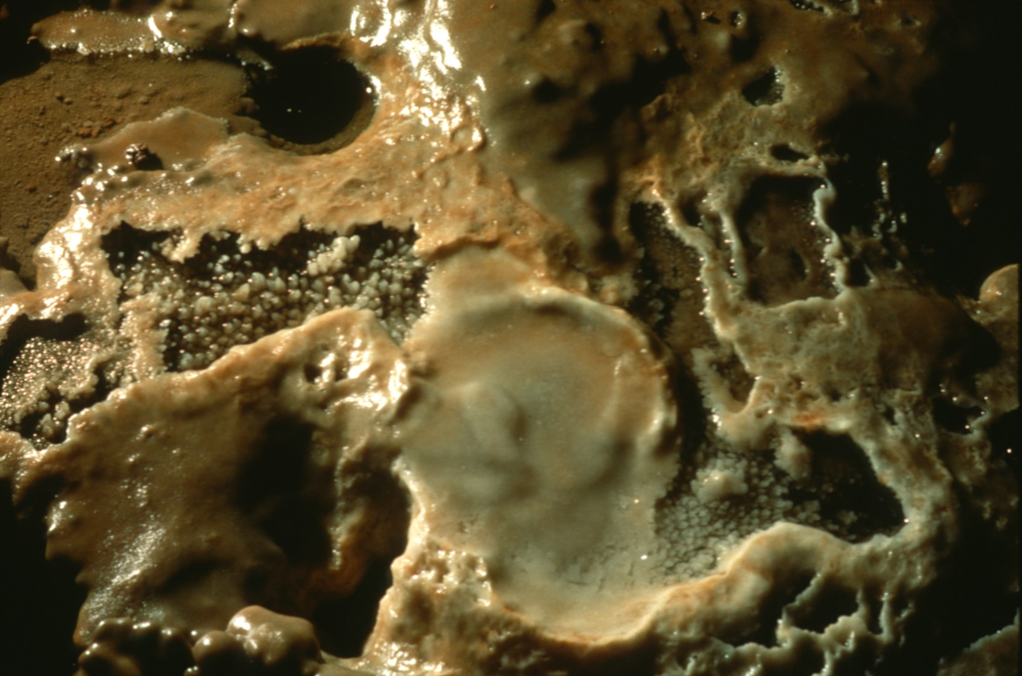
Notes:
are calcite lined pools ...

Slide 27
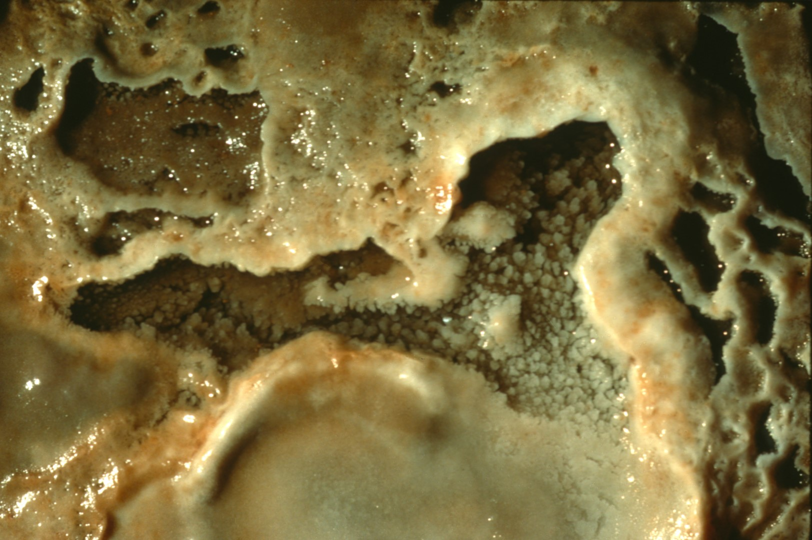
Notes:
with miniature rimstone dams ...

Slide 28
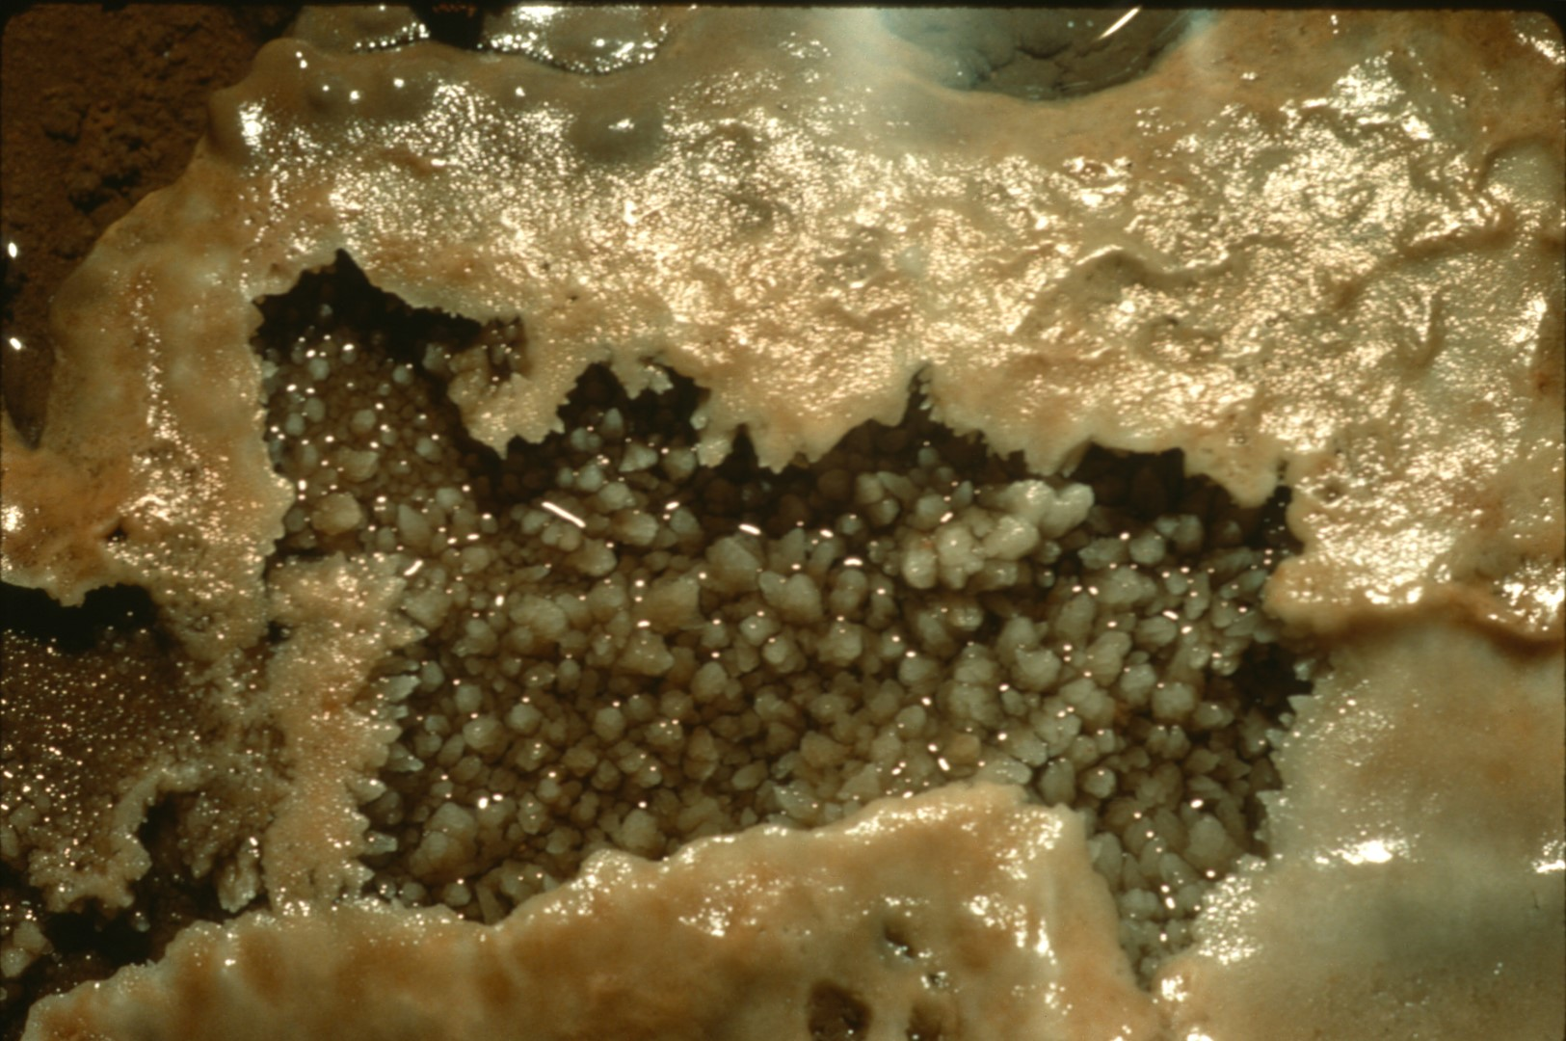
Notes:
and calcite crystals.

Slide 29
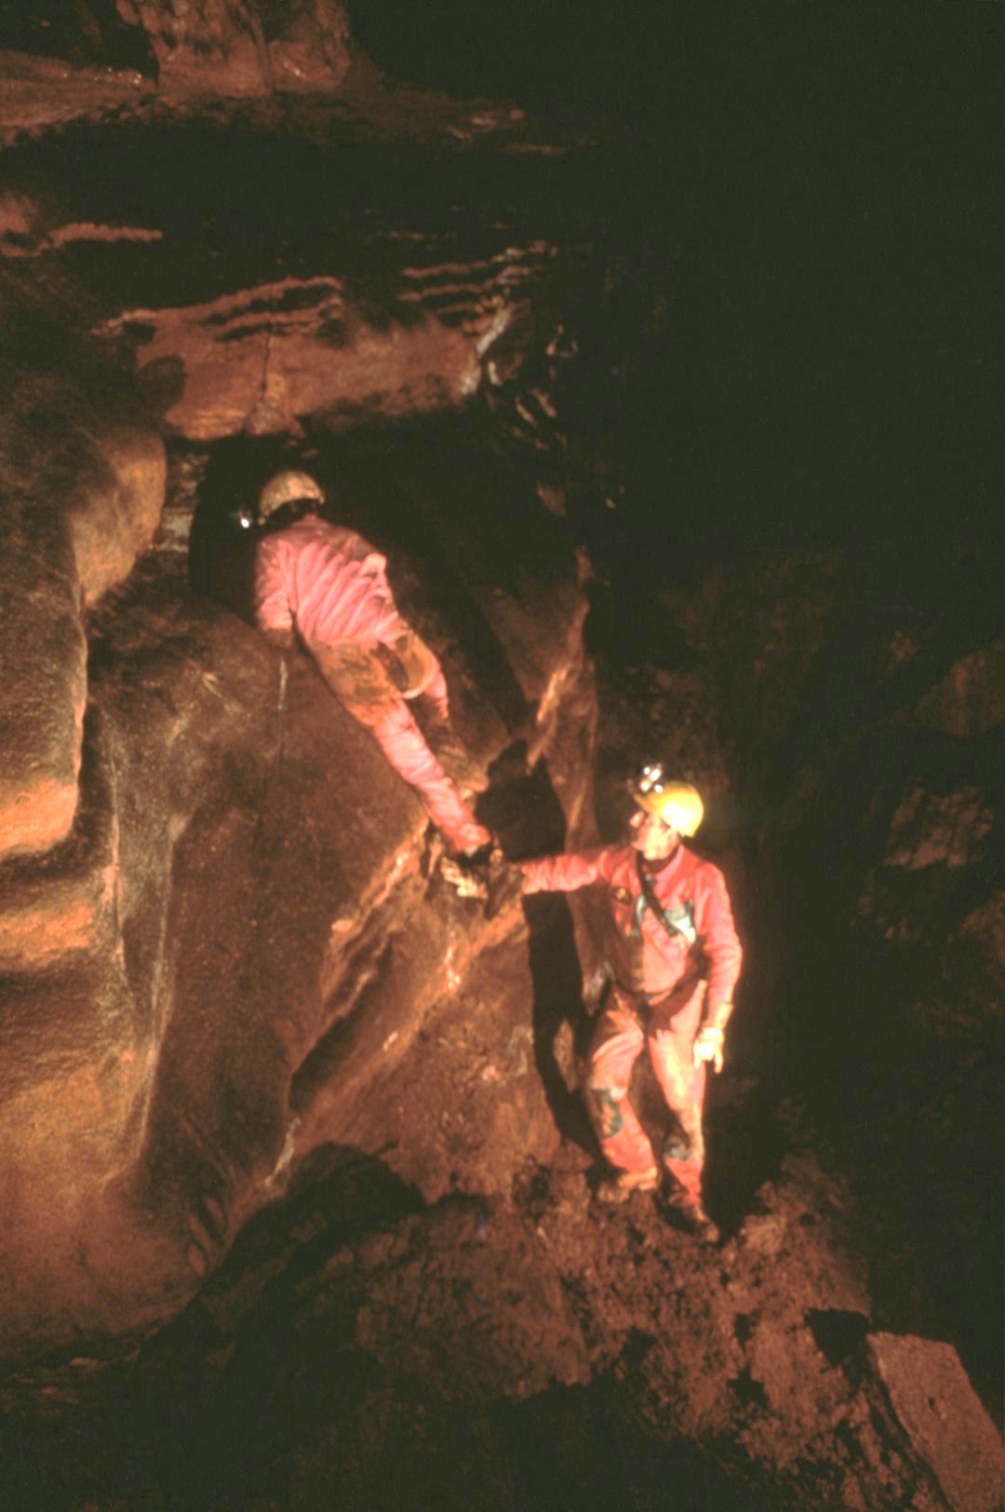
Notes:
The passage appears to end; except for a hole high on the wall ...

Slide 30
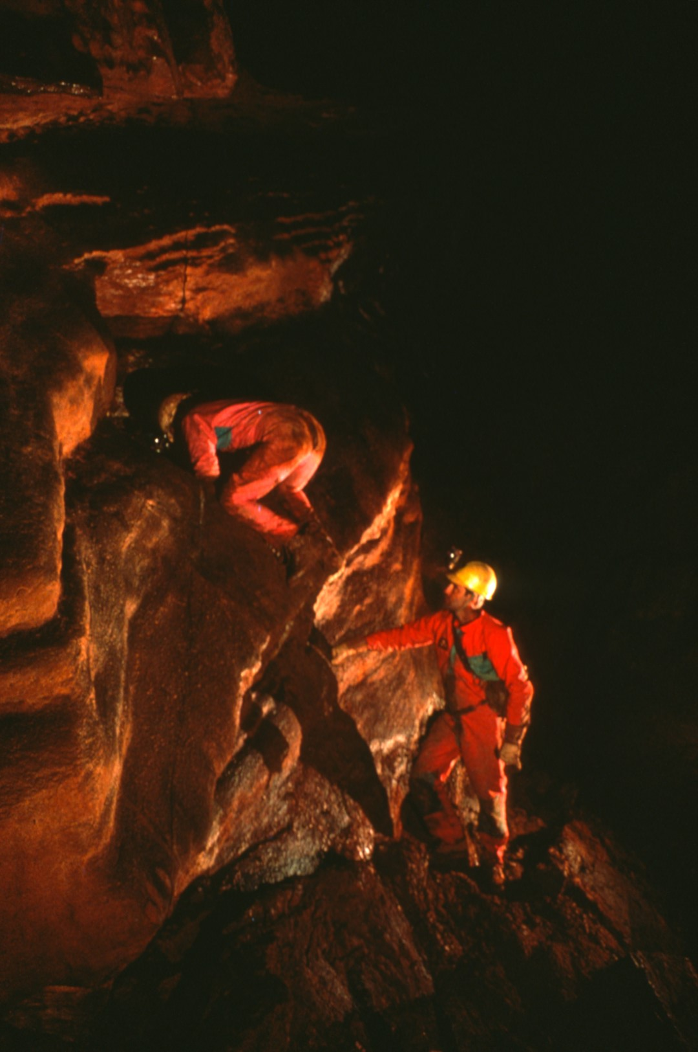
Notes:
known as the Toilet Bowl. You enter 0n top ...

Slide 31
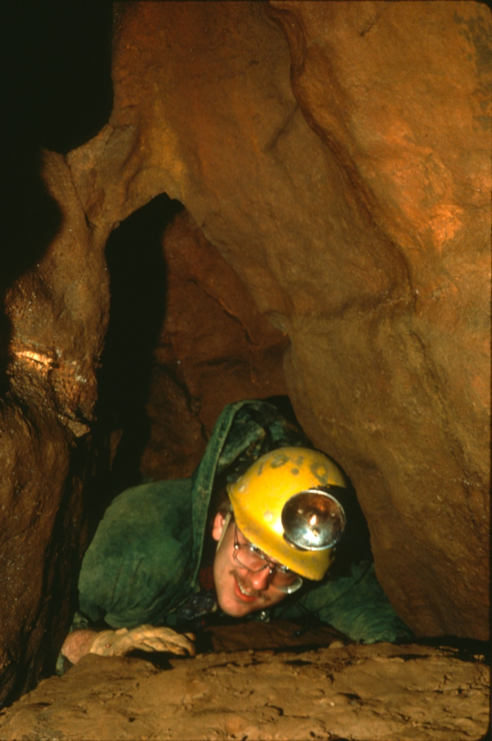
Notes:
and are flushed out the bottom.

Slide 32
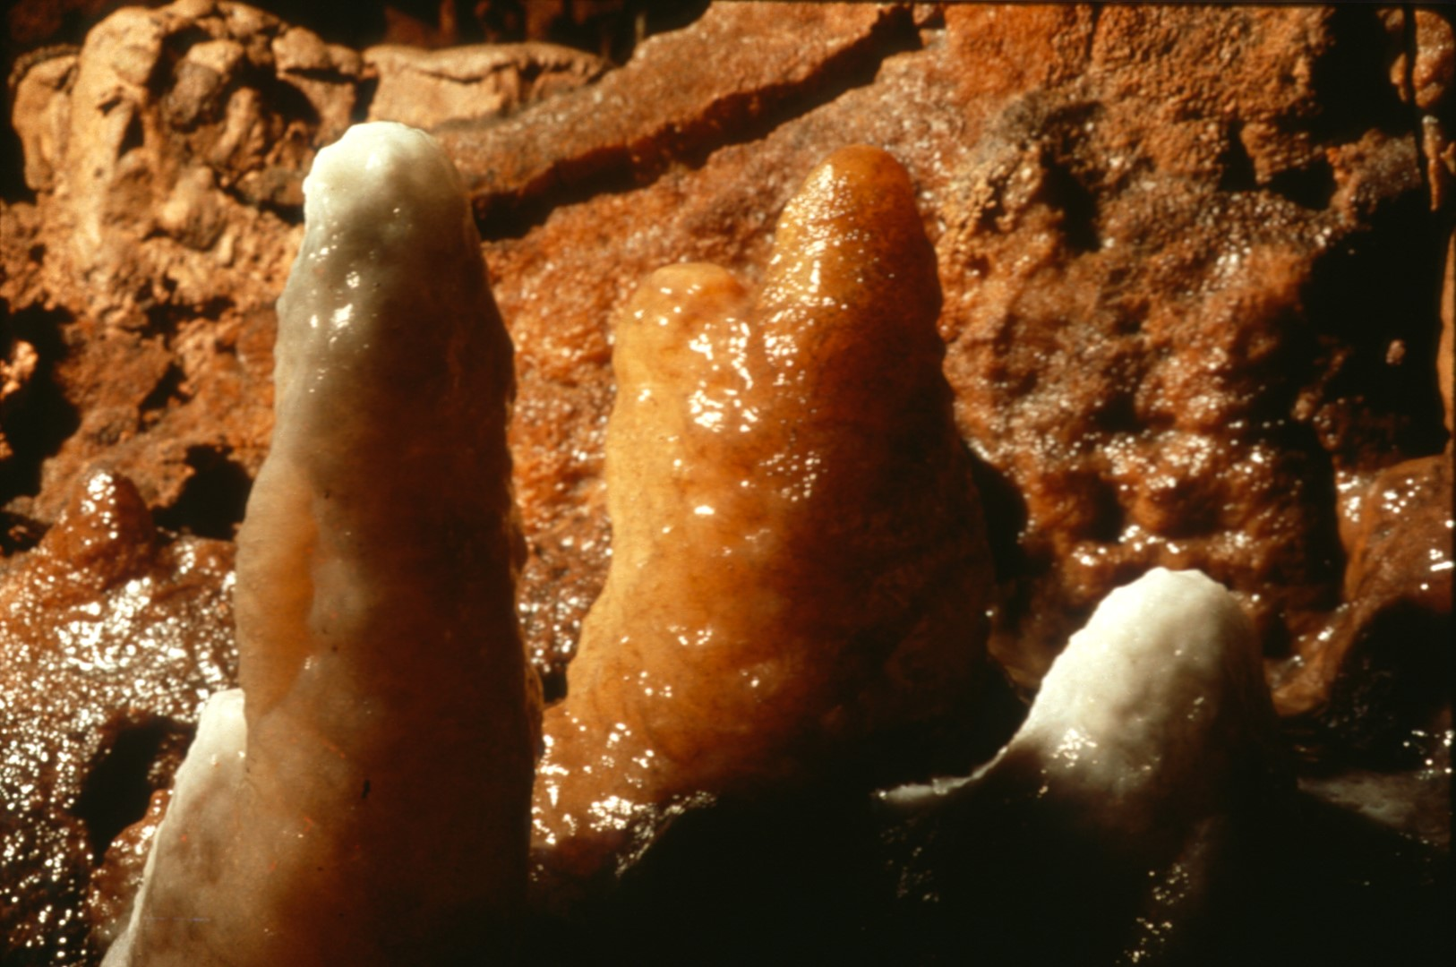
Notes:
Beyond the Toilet Bowl are colorful stalagmites ...

Slide 33
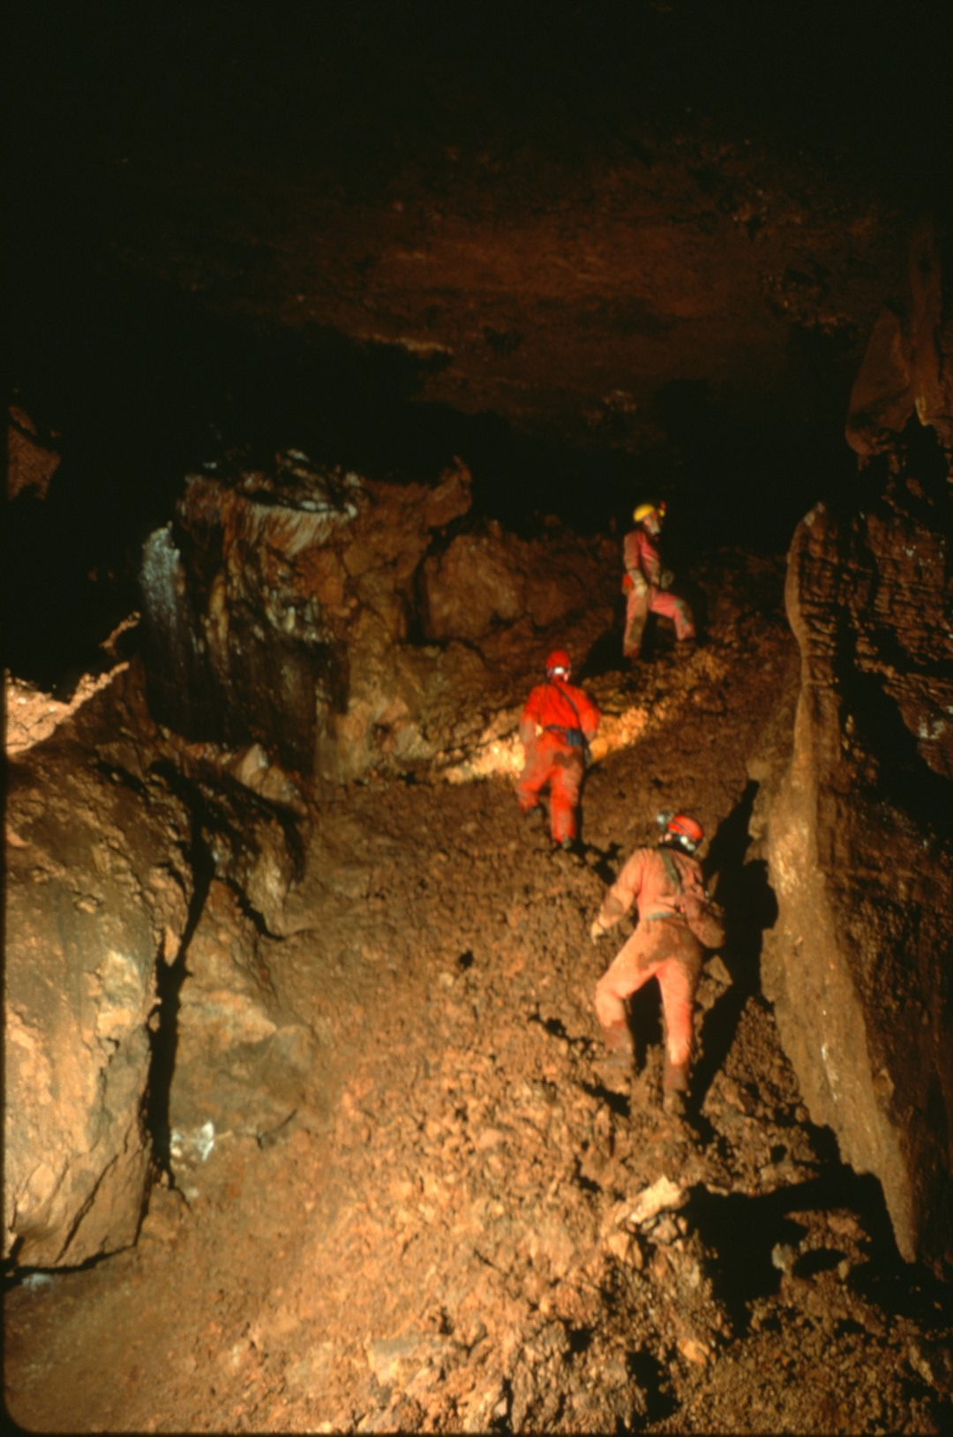
Notes:
and the climb up Mud Mountain ...

Slide 34
Notes:
towards Stull Highway.

Slide 35
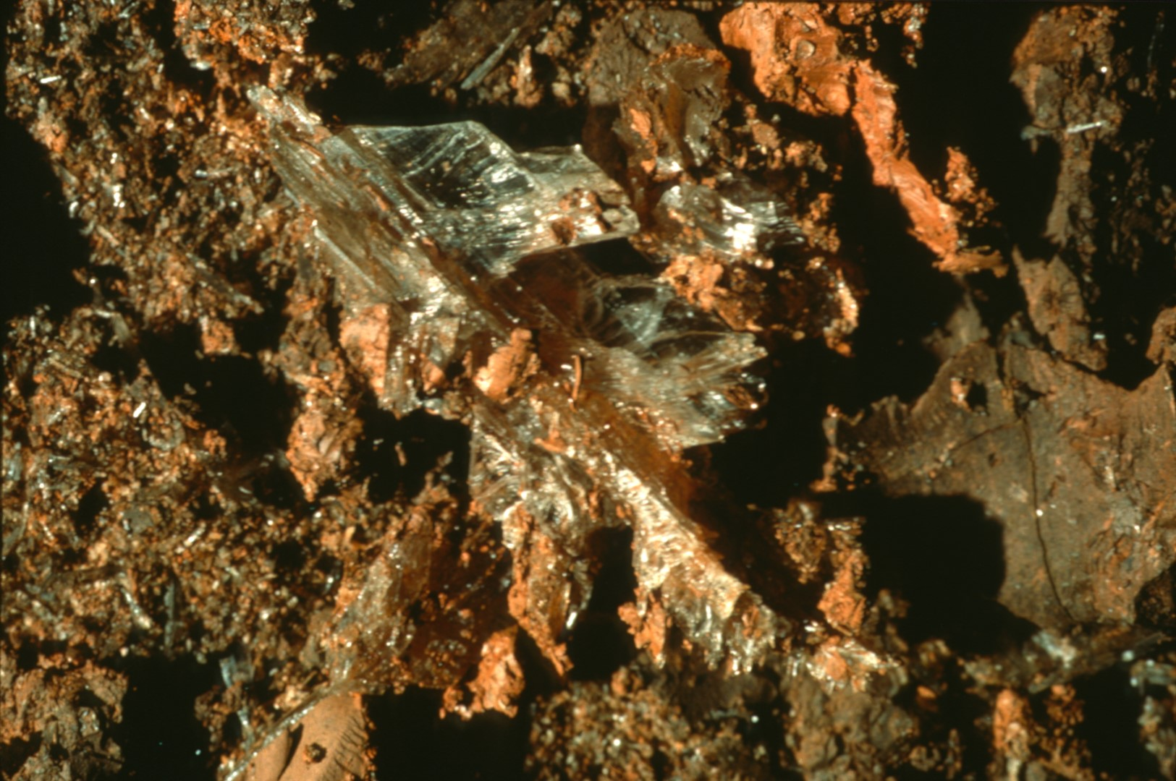
Notes:
One of the more interesting formations in this section are the gypsum spikes ...

Slide 36
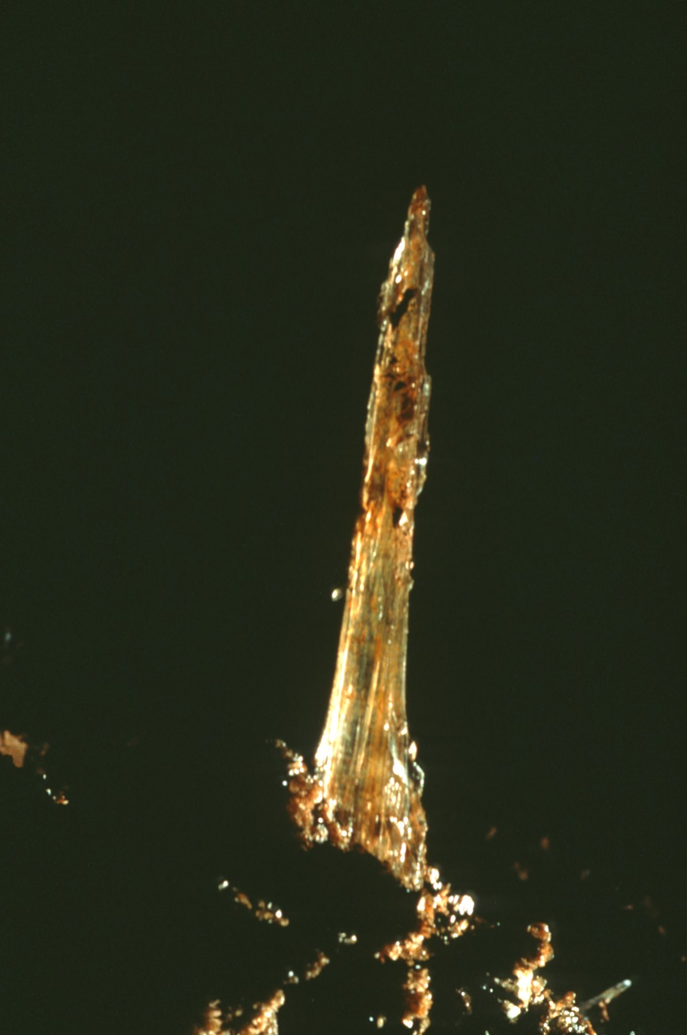
Notes:
some of which are six inches long.

Slide 37
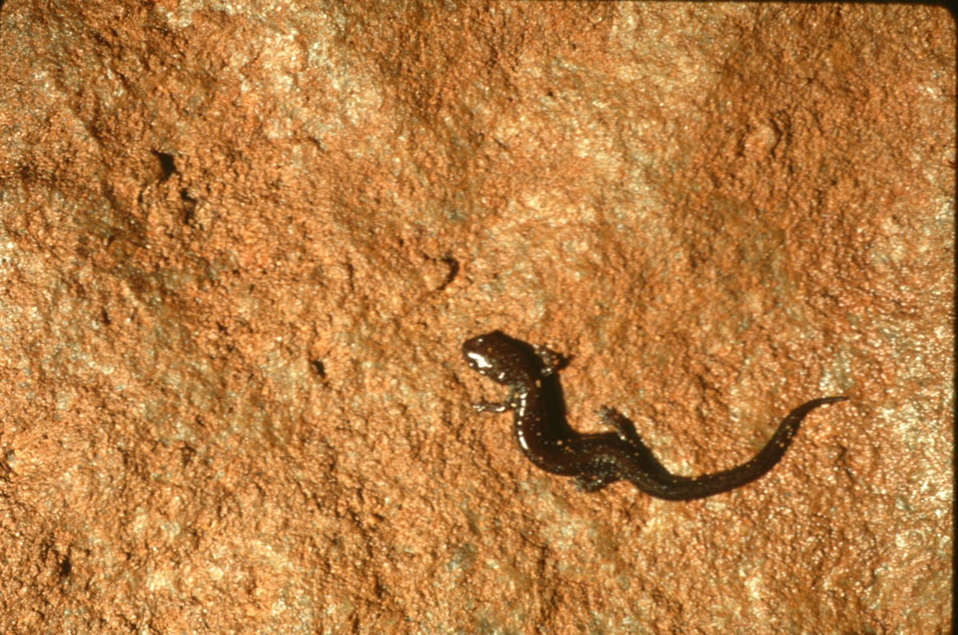
Notes:
One wall of the passage is covered by numerous small salamanders.

Slide 38
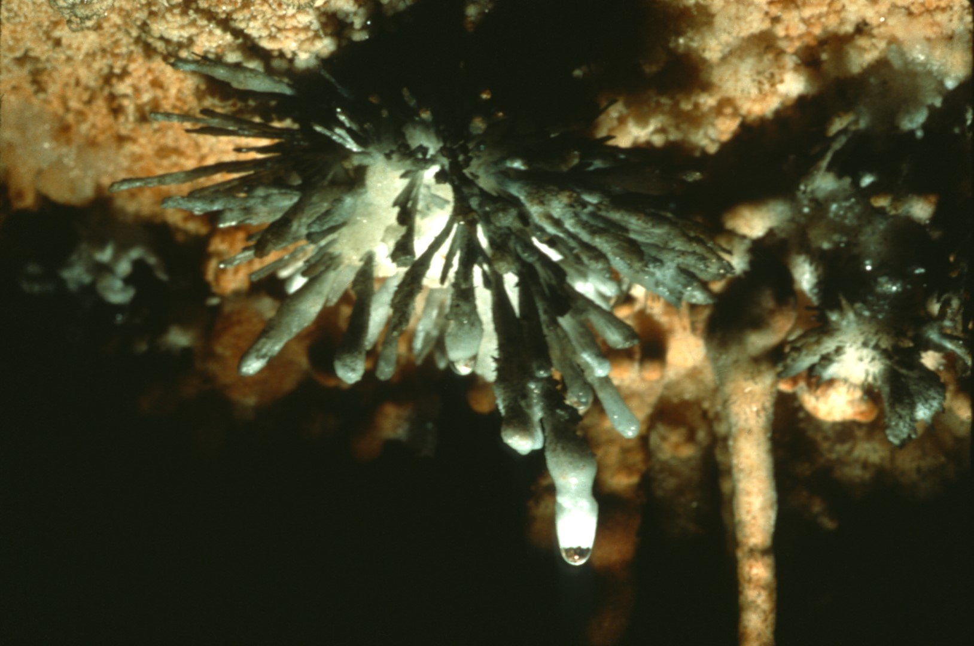
Notes:
Just to the west is Long Shot Alley with its anthodites ...

Slide 39
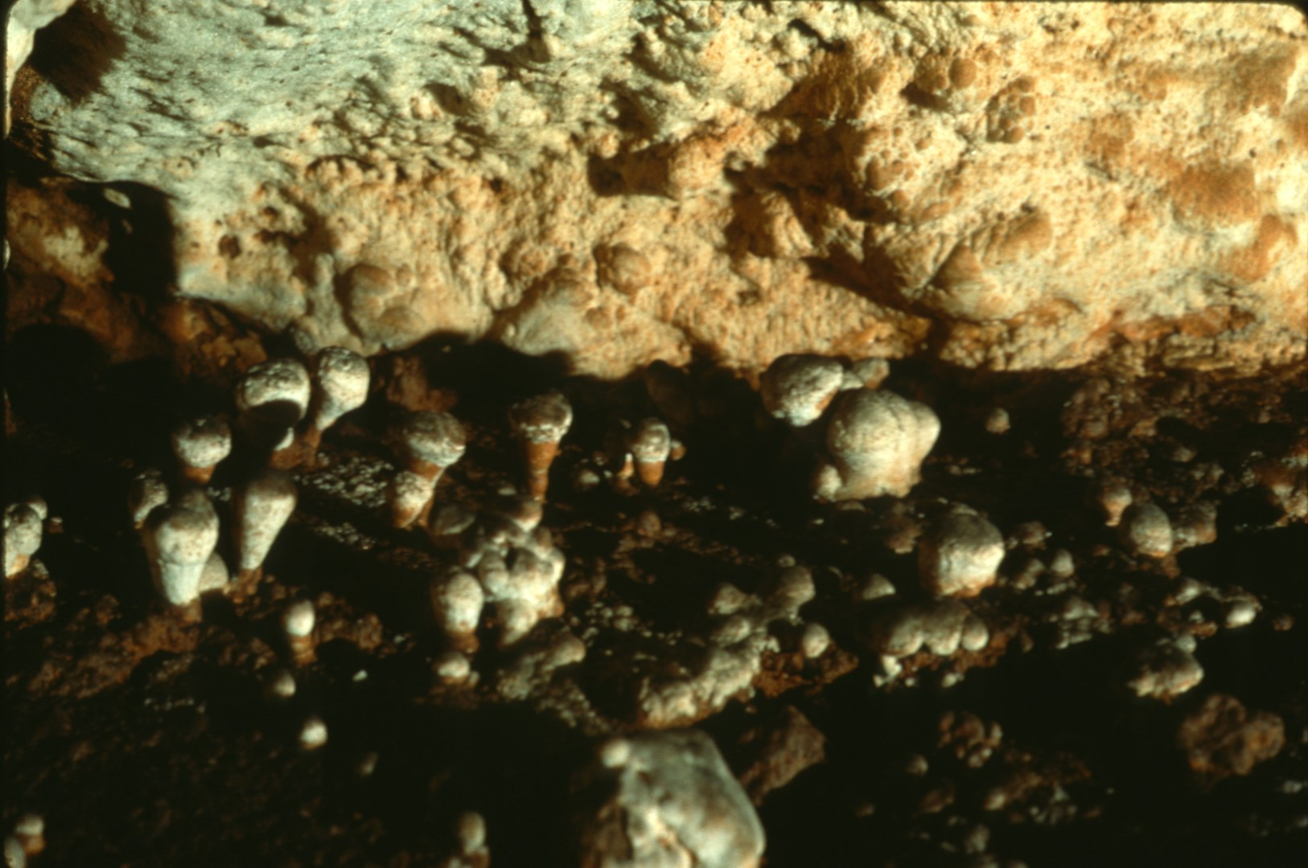
Notes:
peculiar floor popcorn, ...

Slide 40
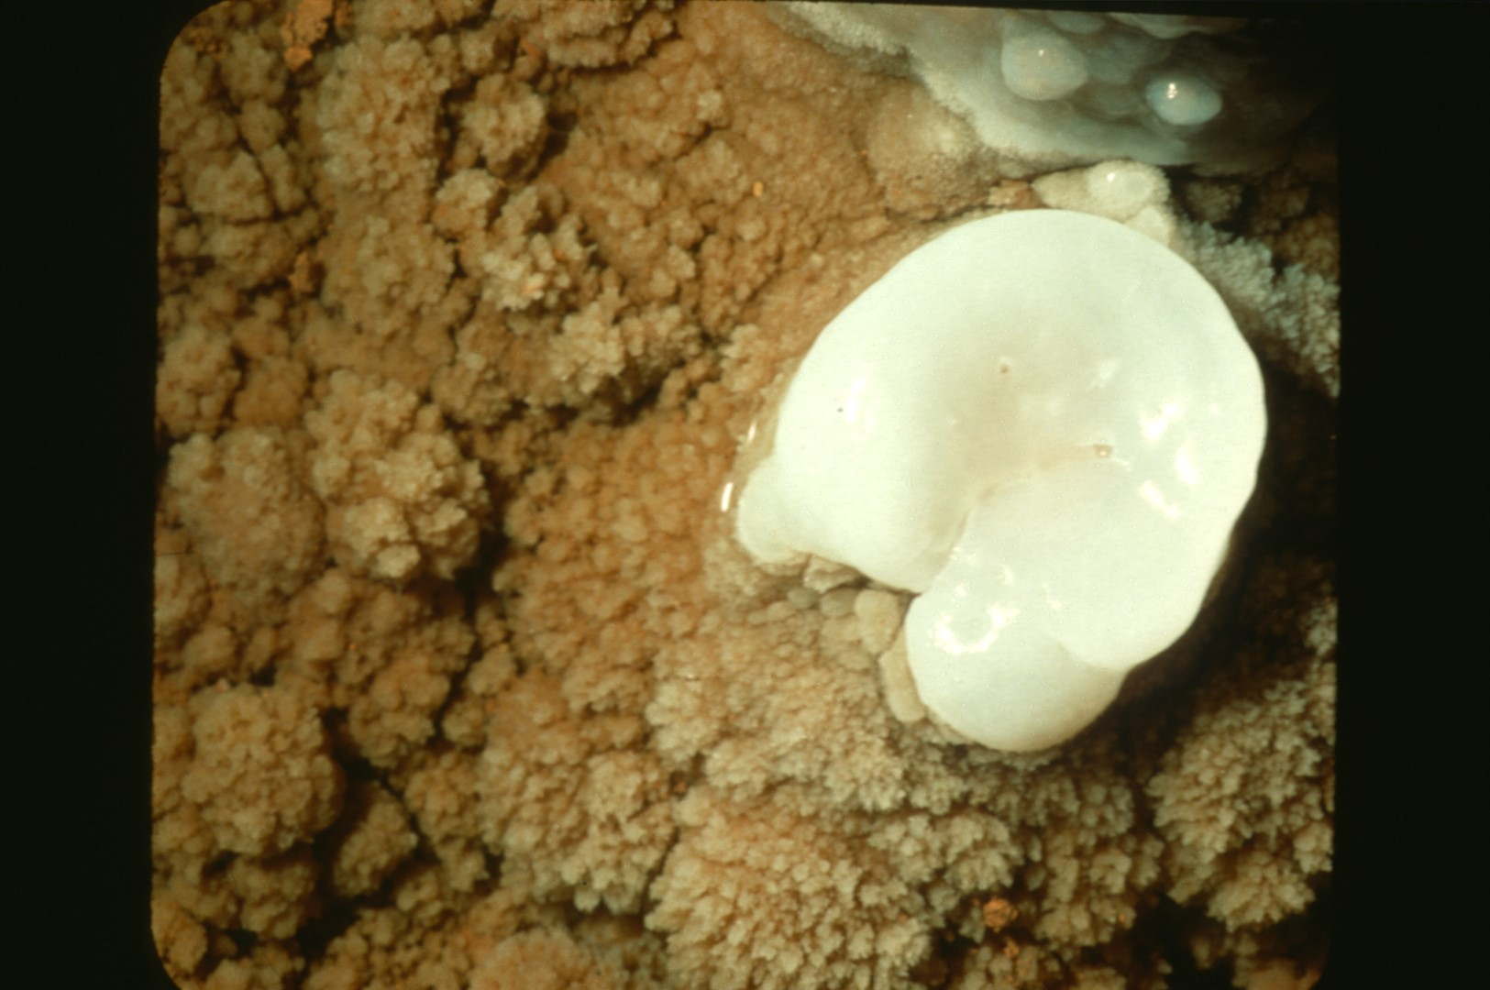
Notes:
calcite lily pads,

Slide 41
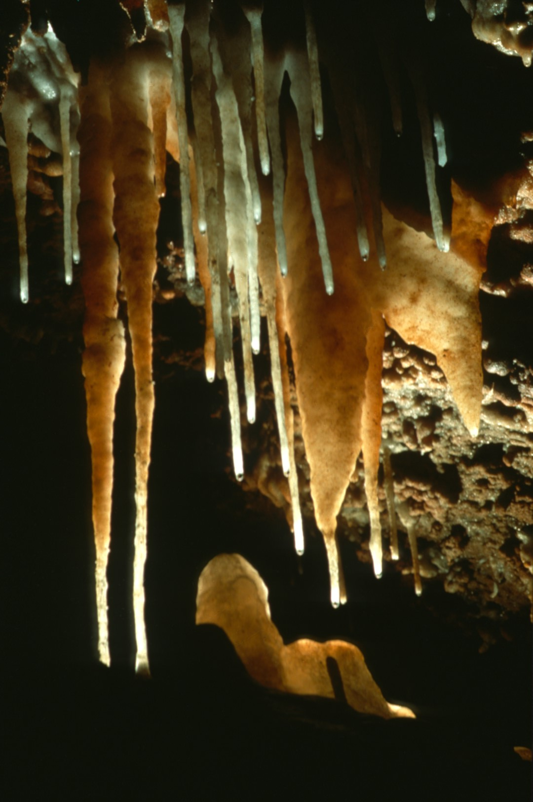
Notes:
and soda straws.

Slide 42
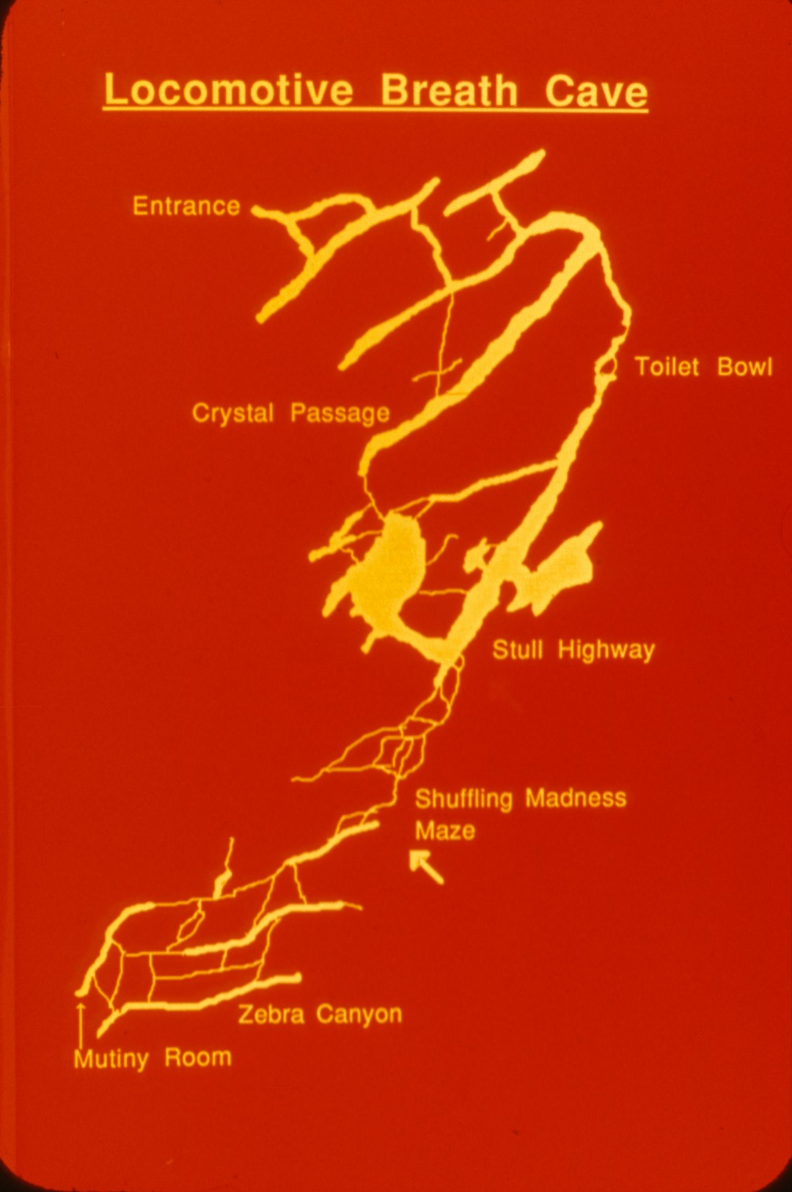
Notes:
As we enter Shuffling Madness Maze ...

Slide 43
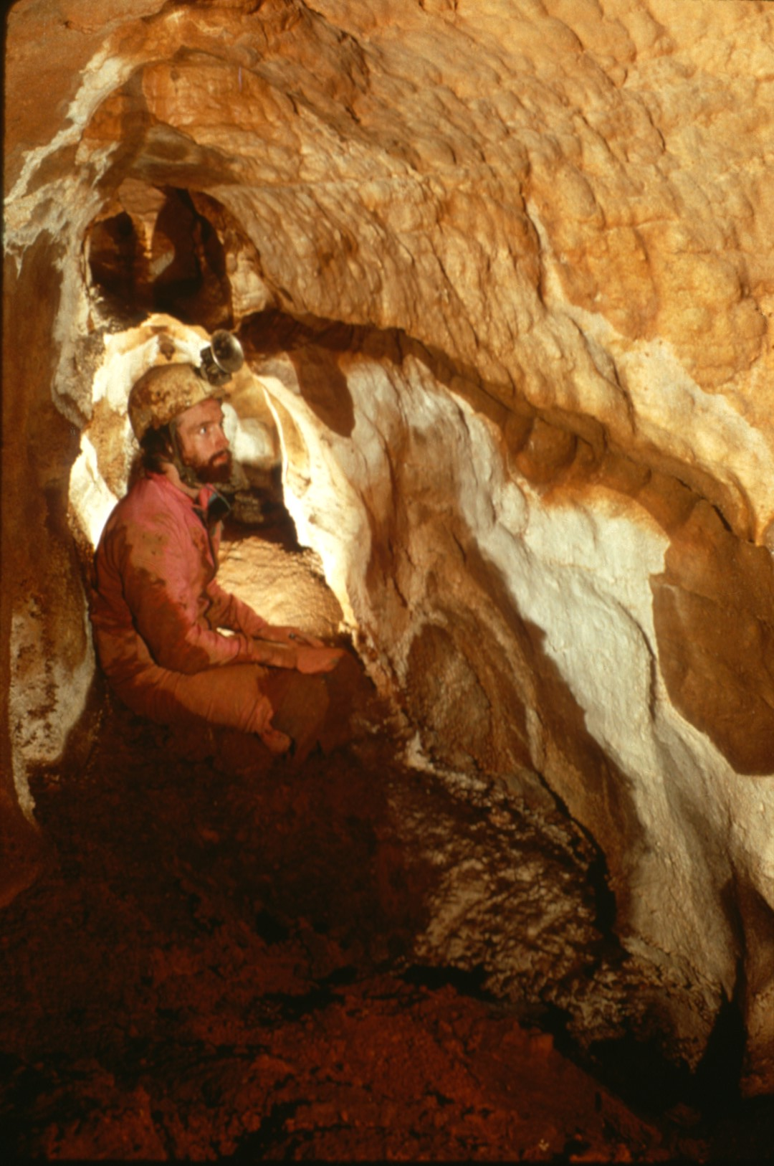
Notes:
the walls are lined with aragonite, ...

Slide 44
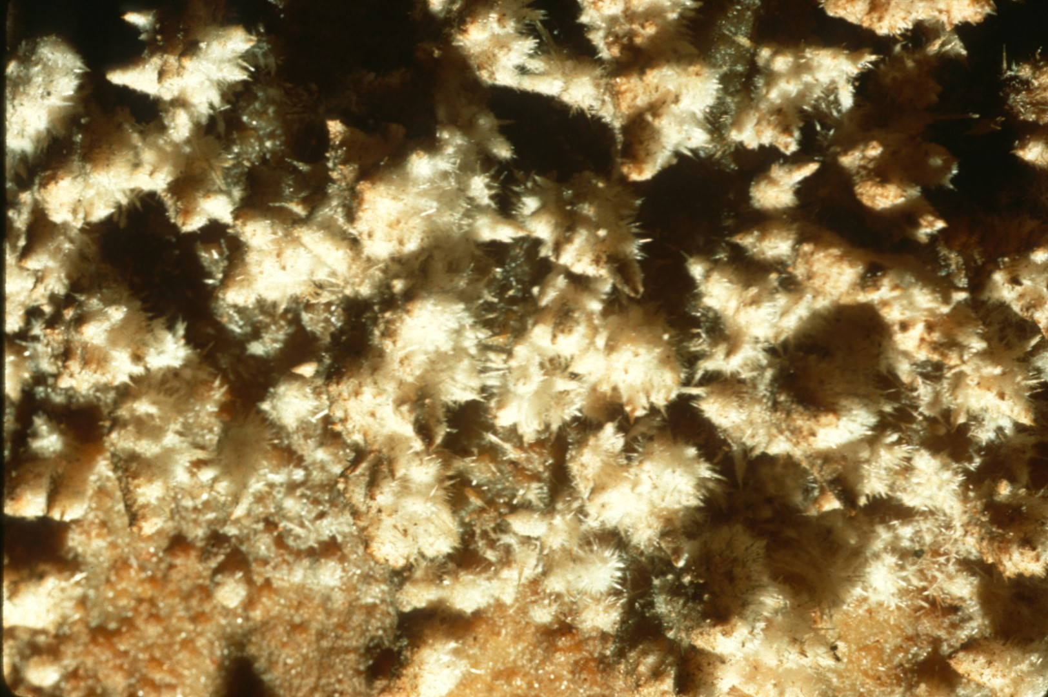
Notes:
which covers much of the passage in the area.

Slide 45
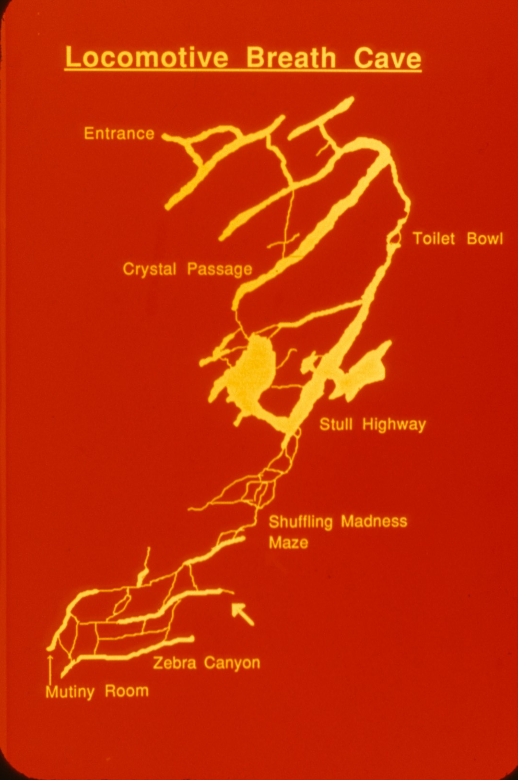
Notes:
The lower end of the maze ...

Slide 46
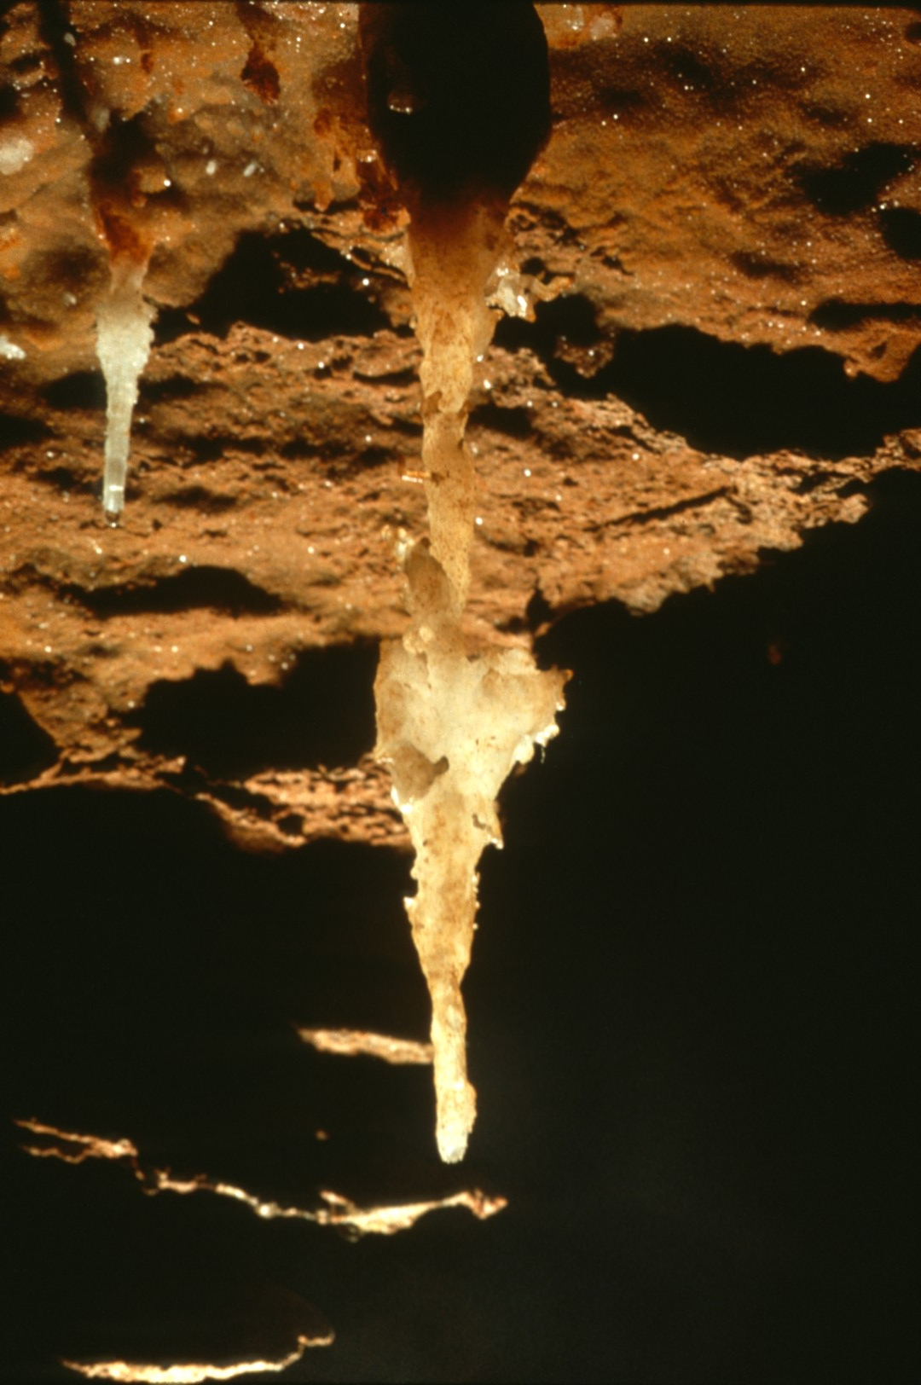
Notes:
contains several nice helictites like this ...

Slide 47
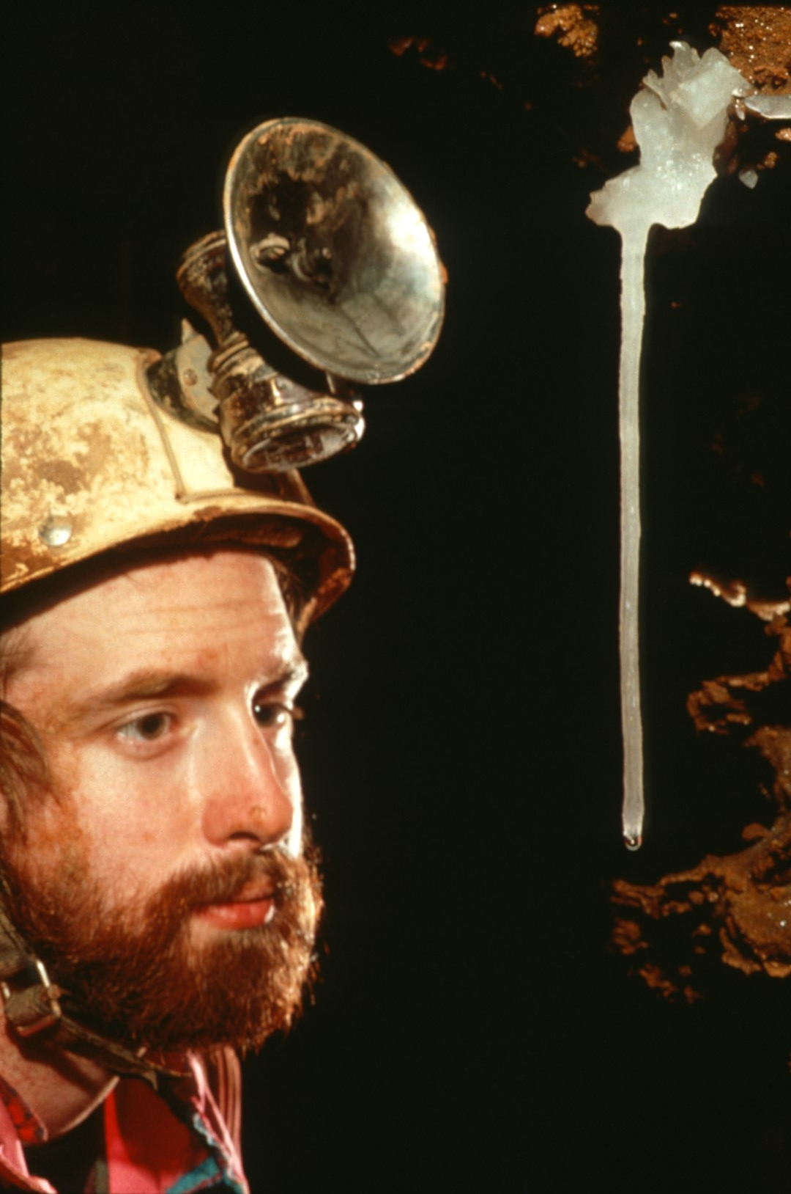
Notes:
and this …

Slide 48
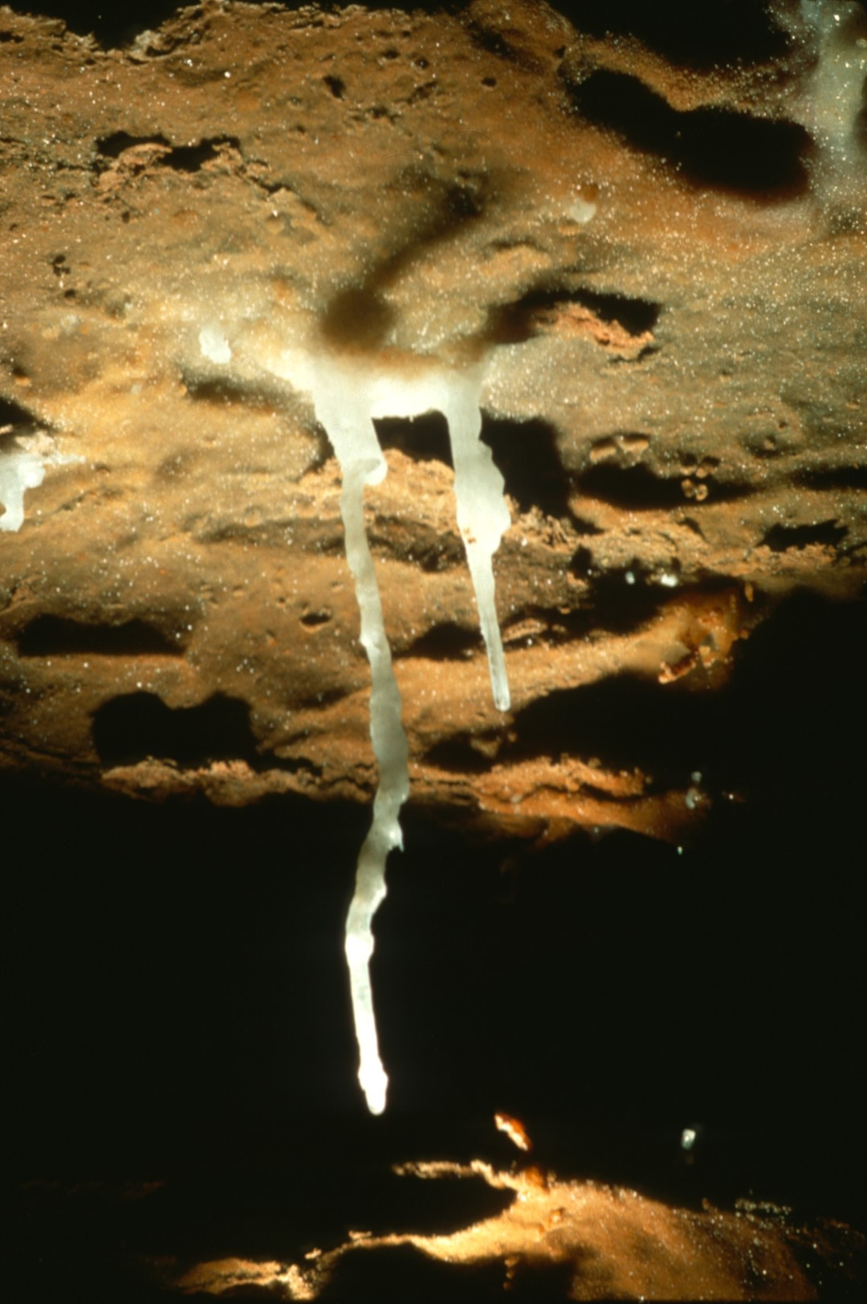
Notes:
including the Nixon Formation, a crooked soda straw.

Slide 49
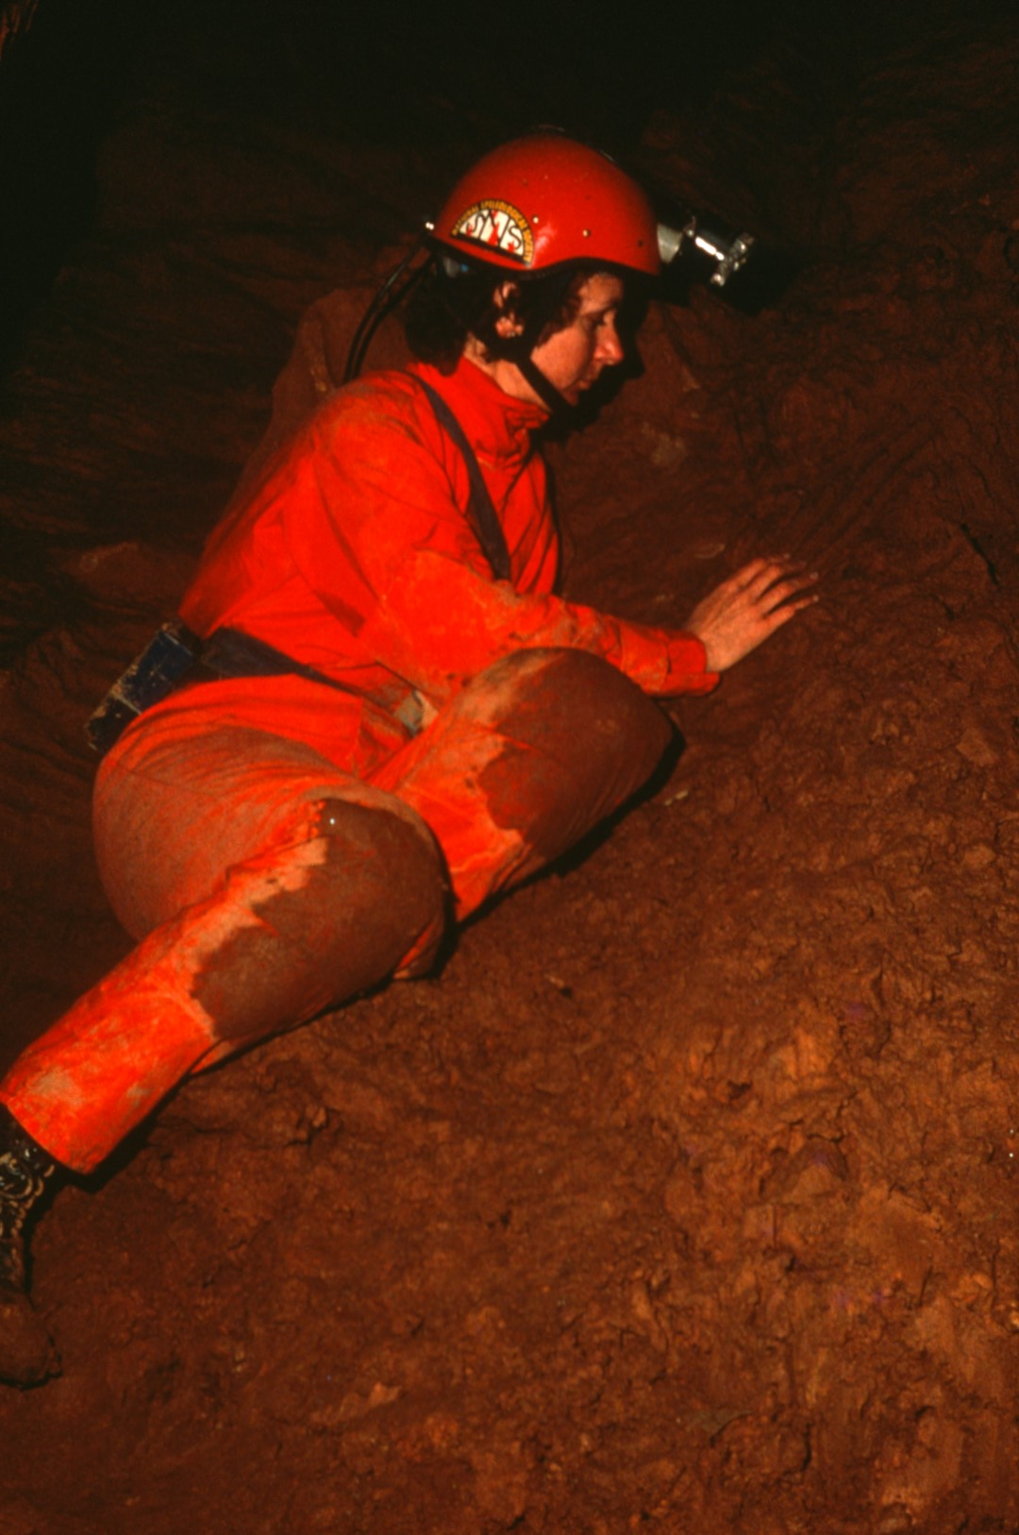
Notes:
In the mud high up along one wall ...

Slide 50
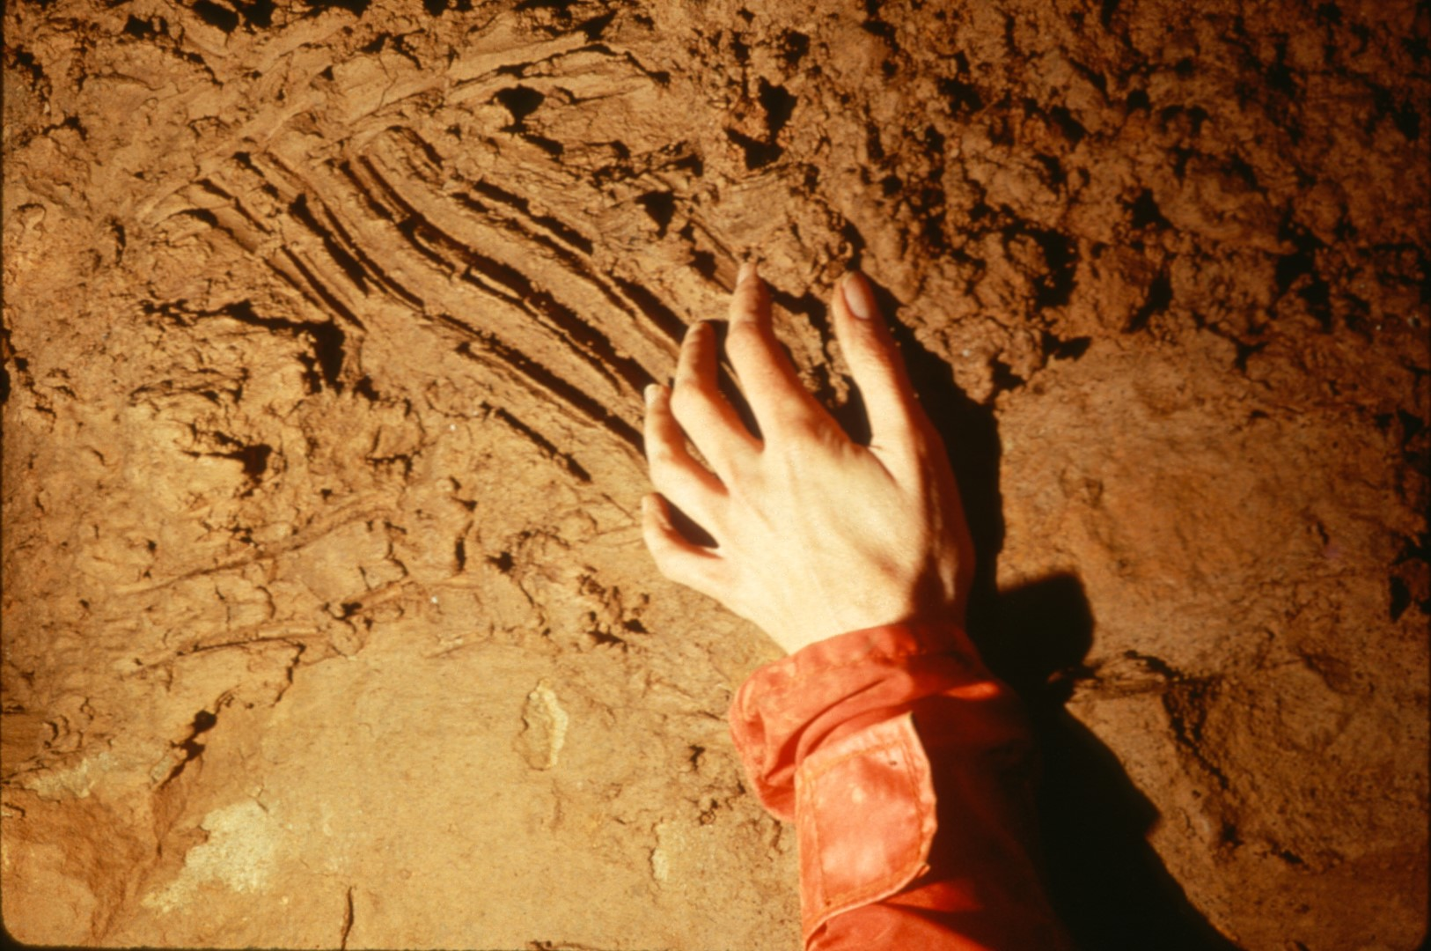
Notes:
are a series of scratch marks perhaps made by a bear.

Slide 51
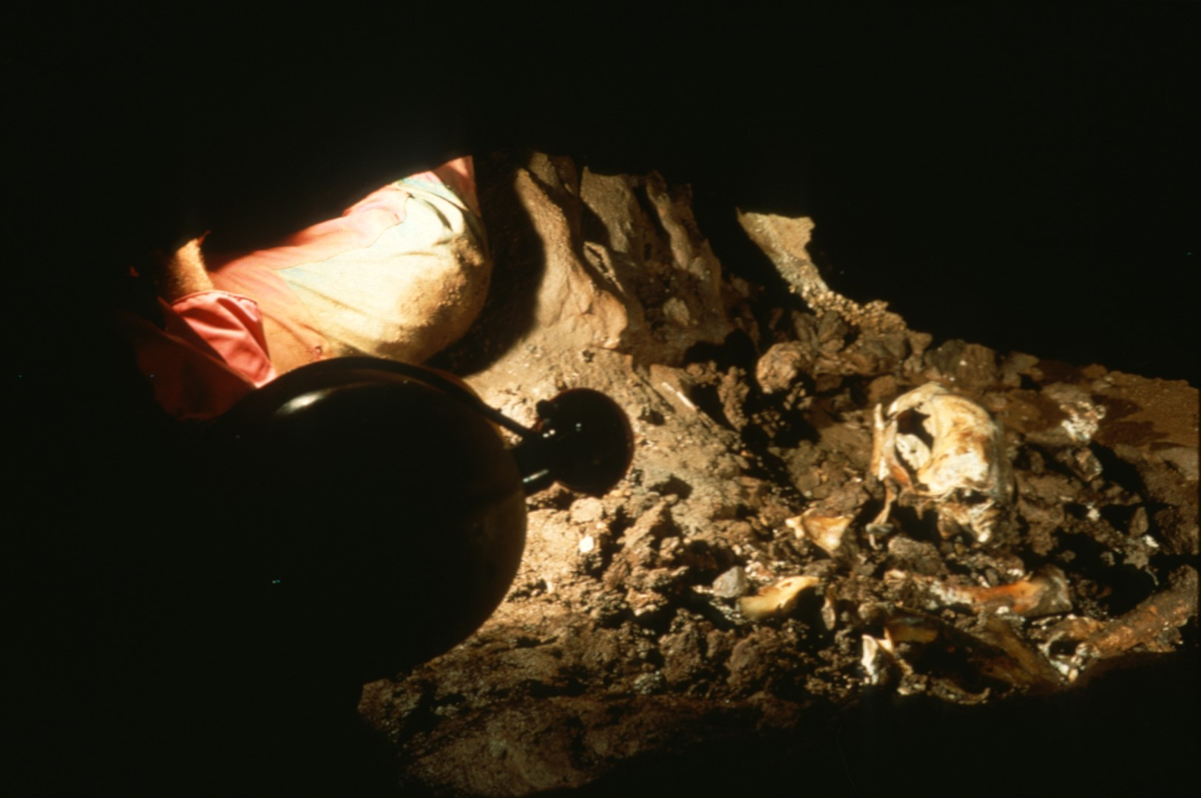
Notes:
Three hundred feet farther into the cave is a collection of bear bones most likely Pleistocene in age.

Slide 52
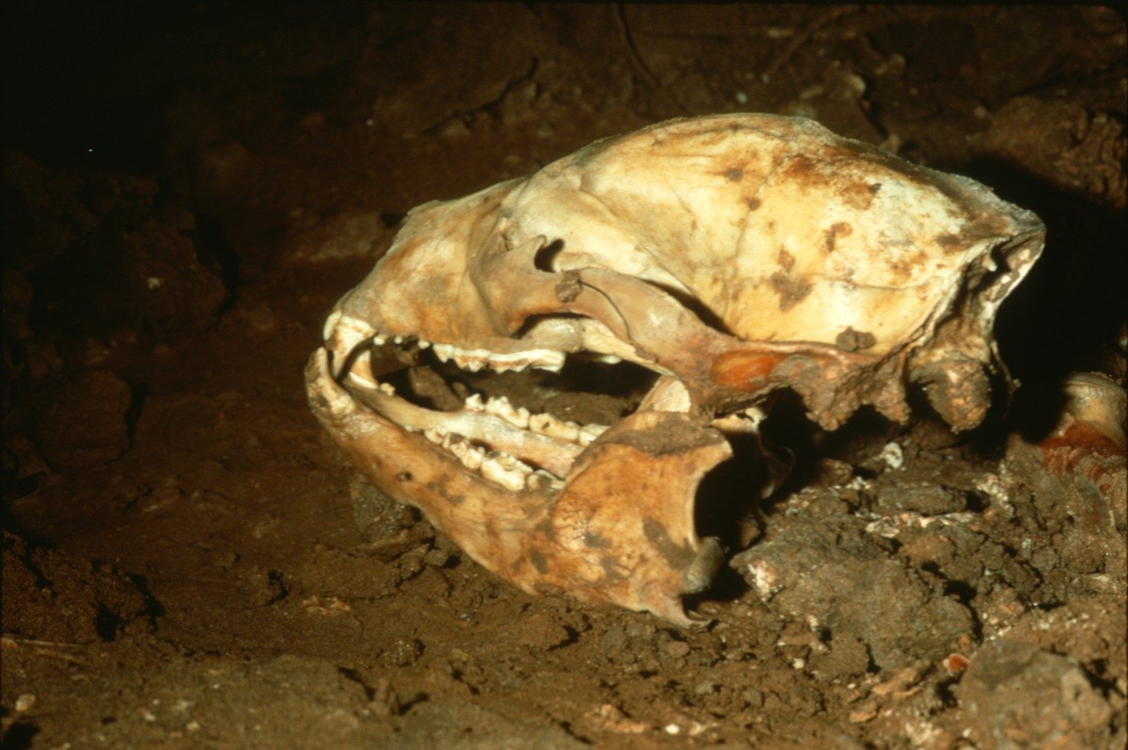
Notes:
The existence of such bones so far into the cave suggests there was another entrance 10,000 years ago.

Slide 53
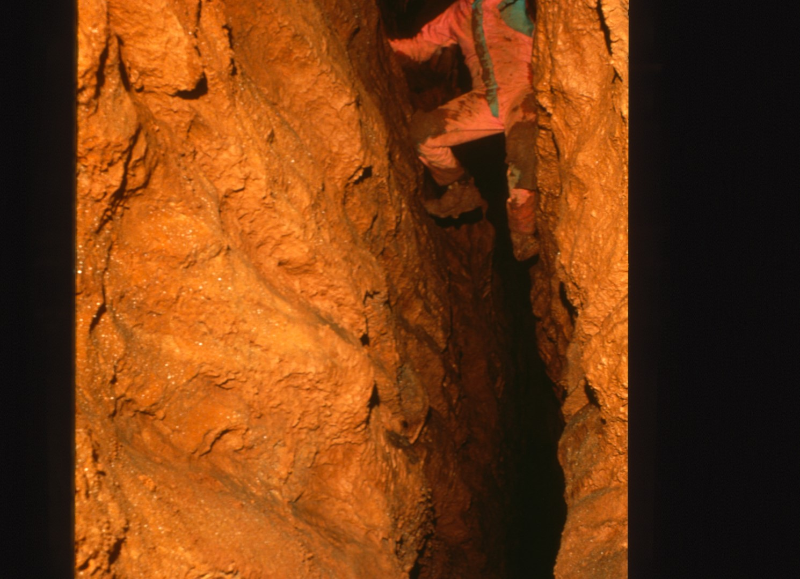
Notes:
The area is crisscrossed by high fissure passages but so far none have led outdoors.

Slide 54
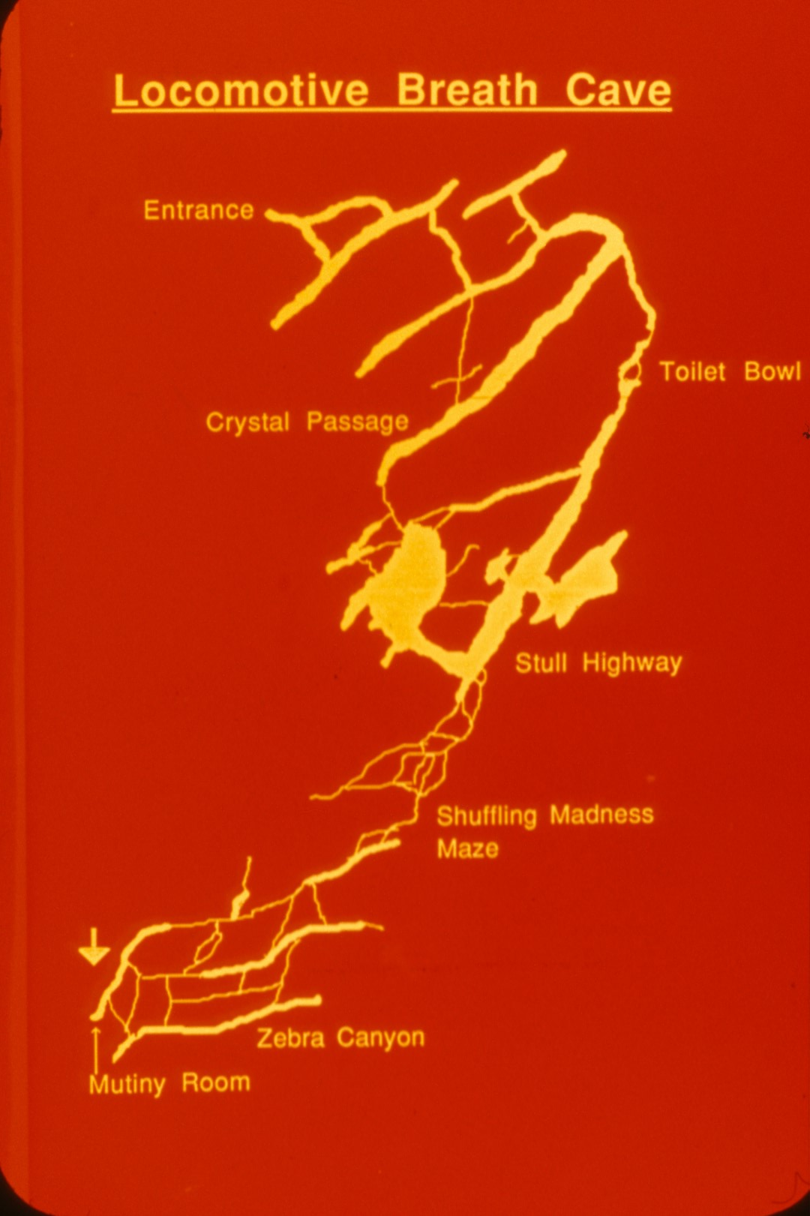
Notes:
Exploration continues beyond the Mutiny Room area of the cave.

Slide 55
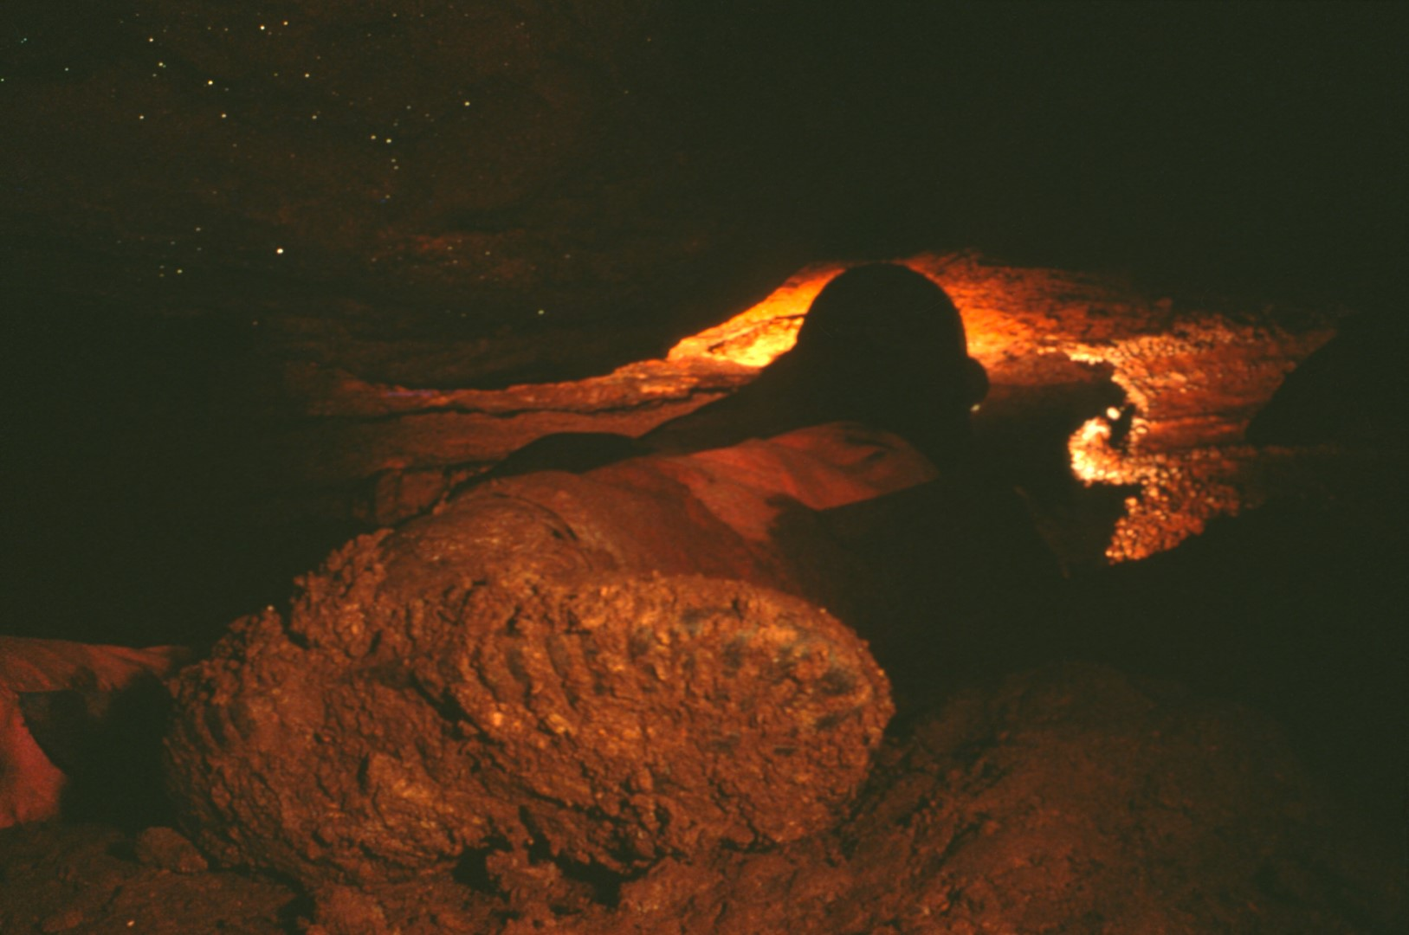
Notes:
More than one trip has aborted at the thought of what lies ahead.

Slide 56
Notes:
Here the passage is low ...

Slide 57
Notes:
and muddy.

Slide 58
Notes:
It's the kind of passage that makes you wonder why you're there.

Slide 59
Notes:
Petticoat Junction at last offers surveyors the chance to re-carbide ...

Slide 60
Notes:
and view some dainty frills.

Slide 61
Notes:
But the leads beyond become tighter. So much so that it takes a buddy …

Slide 62
Notes:
to pull you out.

Slide 63
Notes:
No wonder it's hard to find cavers who will survey the unexplored passage beyond.

Slide 64
Notes:
Locomotive Breath Cave is one of Alleghany County's more spectacular caves. To enter it you must cross private land which should be done only with the permission of the landowner.

Slide 65
Notes:
This program was developed and written by Paul Stevens. The photography was done by Paul & Lee Stevens with contributions by Tom Spina.

Slide 66
An NSS Audio-Visual Library Presentation
Locomotive Breath Cave, VA
By Paul and Lee Stevens
Original slide program S745
Slides digitized by David Caudle
PowerPoint program created by David Socky
68 slides, with script in presenter notes
PowerPoint created 2/14/2021
National Speleological Society
6001 Pulaski Pike
Huntsville, AL 35810-1122
256- 852-1300
nss@caves.org
https://caves.org/
Notes:
For further information contact the National Speleological Society, 6001 Pulaski Pike, Huntsville, AL 35810 and for the current address of the Virginia Speleological Survey.

